Slide 1
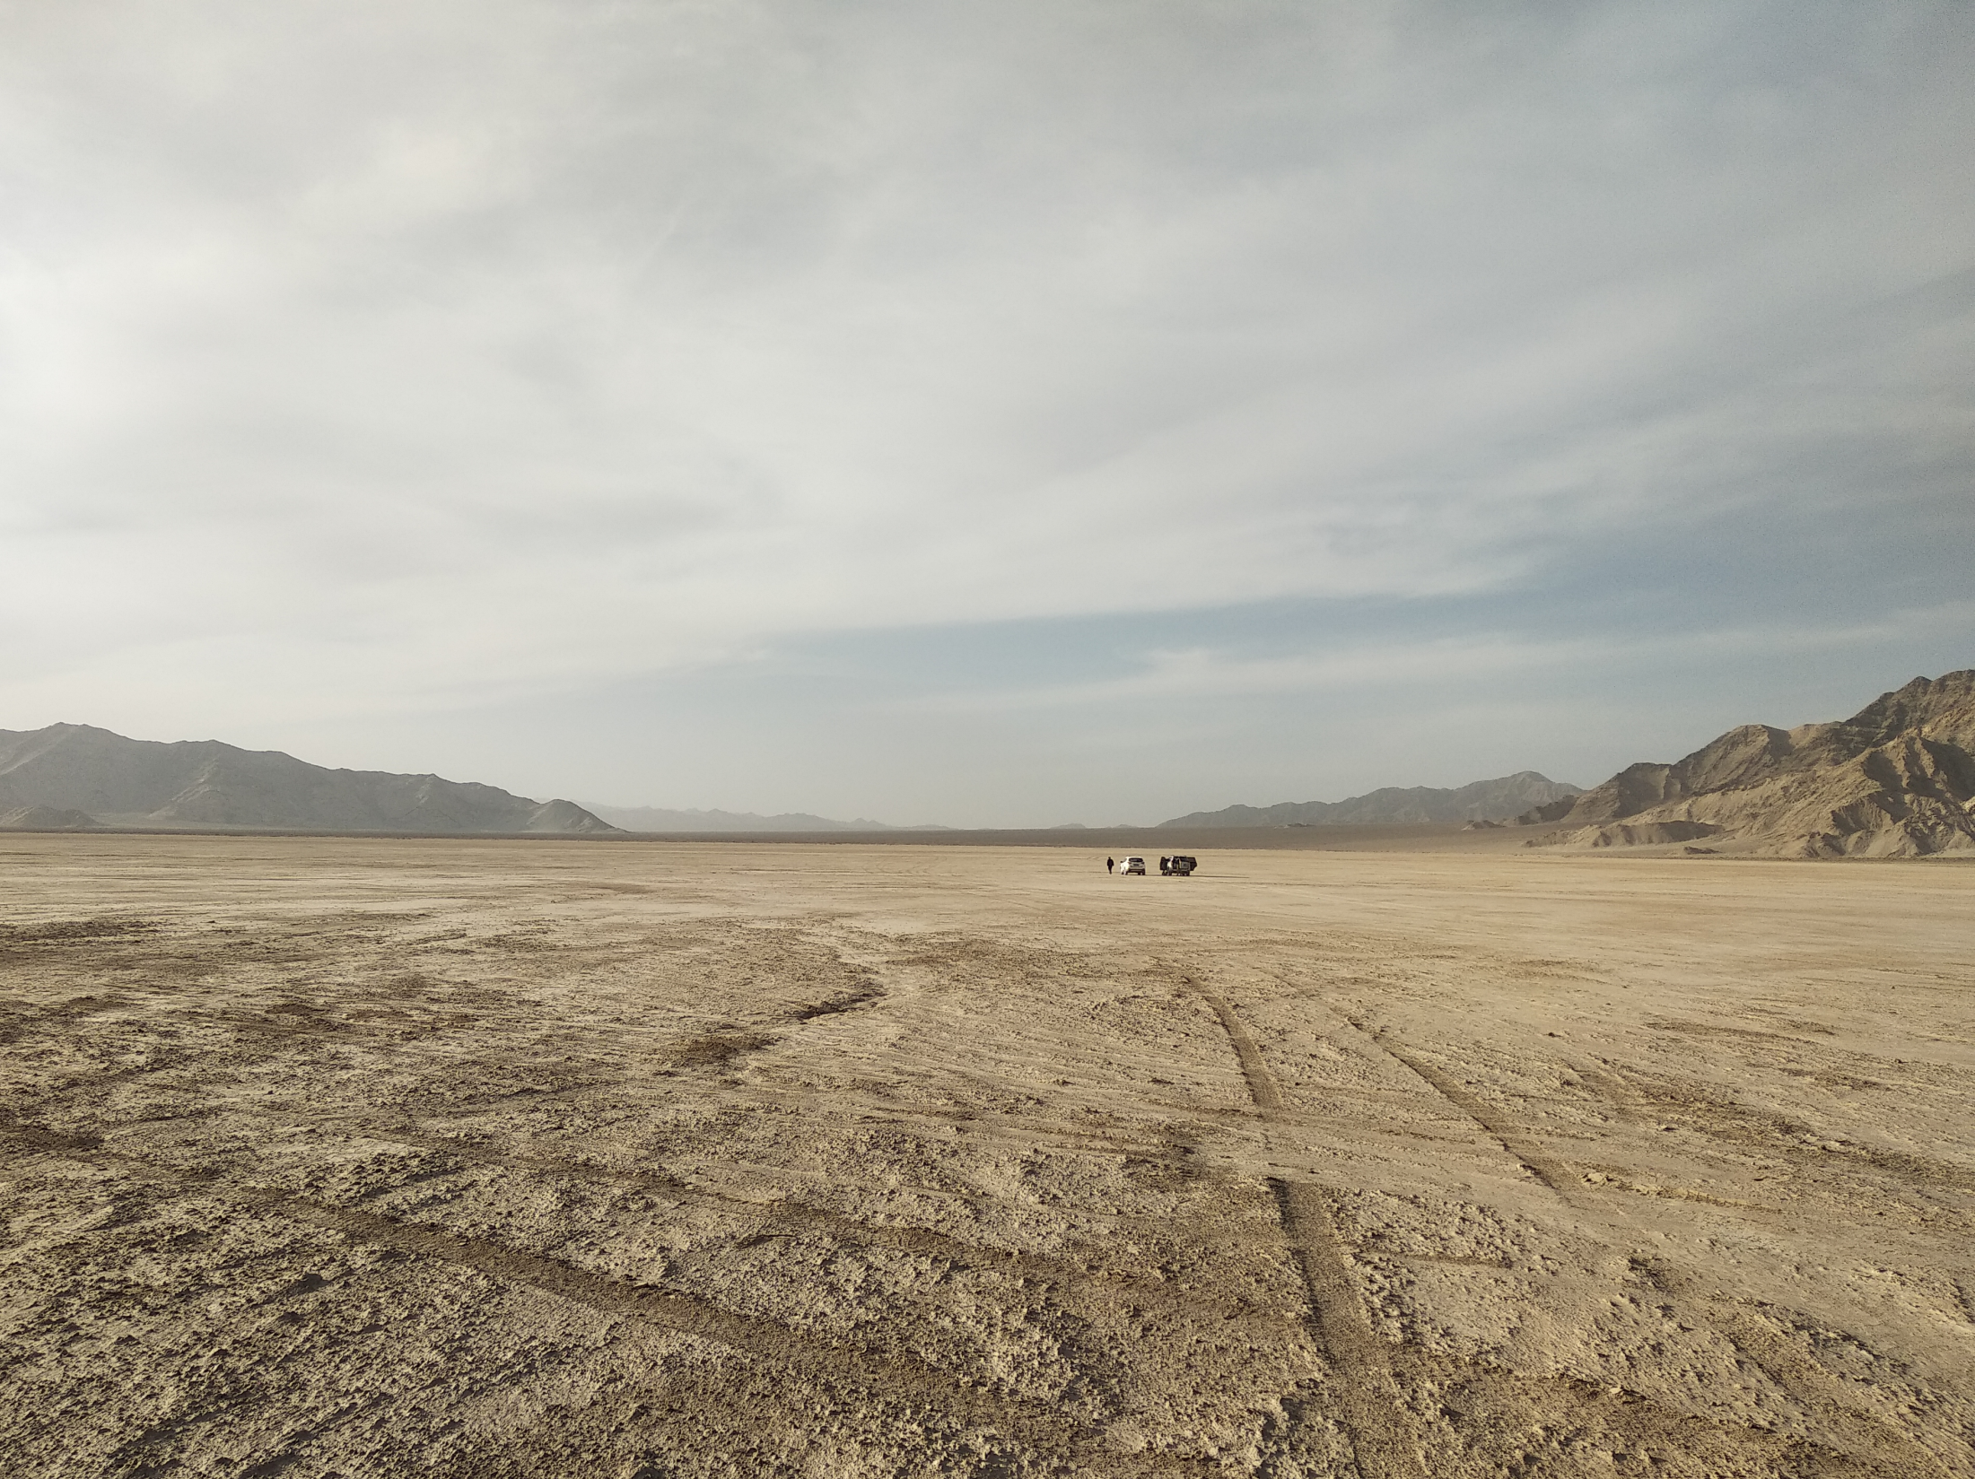
The giant Radio array for neutrino detection
Olivier Martineau-Huynh for the GRAND collaboration,
ICRC2019, Madison, WI, July 31, 2019
http://grand.cnrs.fr/
LengHu, QingHai province, China
Home of the GRANDProto300 experiment

Slide 2
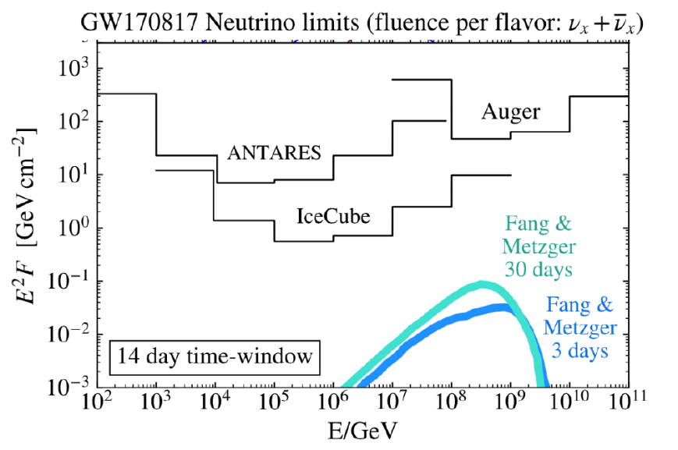
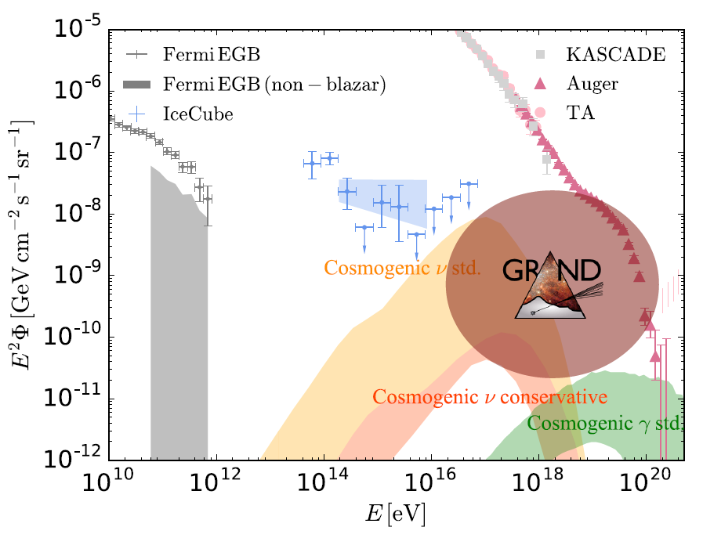
Why UHE neutrinos?
Clean probe of the Universe
E>10¹⁷eV neutrinos is uncharted territory
Direct link to highest energy CRs (5%/A of primary energy)
Transient multimessenger astronomy
What it would take:
Gain of factor ~100 in sensitivity
Large FoV (~full sky)
Precise angular reconstruction (~0.1°)
Decent energy reconstruction (spectrum)
[1810.09994]

Slide 3
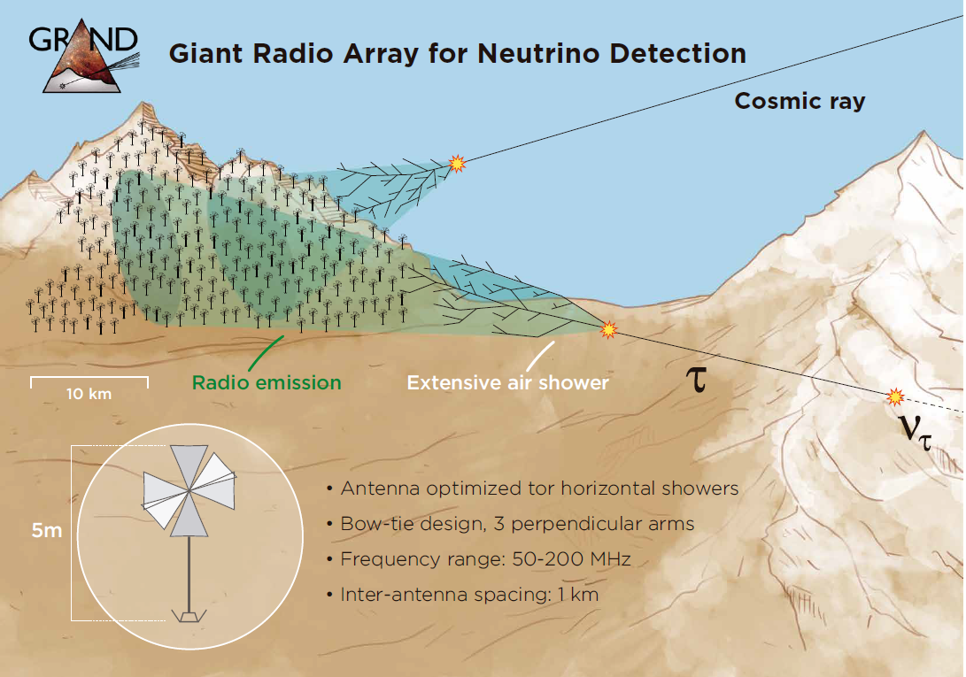
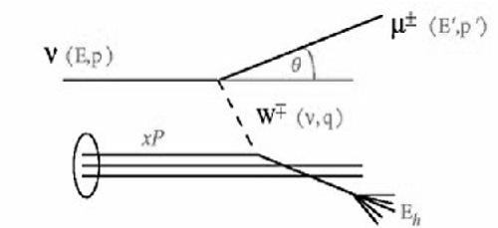
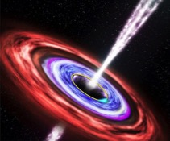
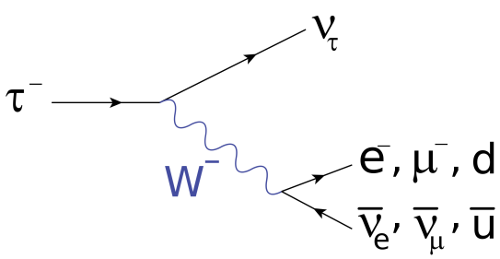
τ±
Detection principle:
ν-induced tau decays in atmosphere generate ~horizontal extensive air showers [Fargion 9906450]
Very indirect process ⬄ very unlikely  low flux ➔ need a GIANT² detector.
Earth opaque to neutrinos at these energies. The tau particle has to be produced less than ~100km from Earth surface in order to emerge ➔ short underground travels ➔ Earth-skimming trajectories.
Radio-detection

Slide 4
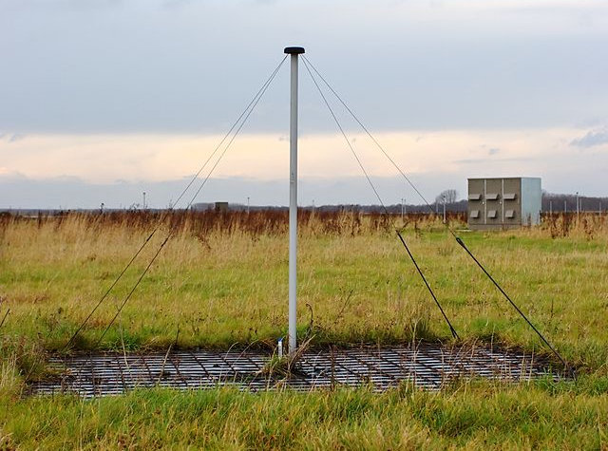
Radio detection of very inclined showers
50-200MHz radio emission of a 10^{17.5}eV shower viewed from the side:
➔ ~10s of km² detectable footprint @ ~100 km from decay point!!
A LOFAR antenna
Background level: 15µV/m
Use
Elevation (km)
Use mountains as projection screen for radio emission
Cheap, light, robust and stable
➔ Perfect for giant arrays!☺

Slide 5
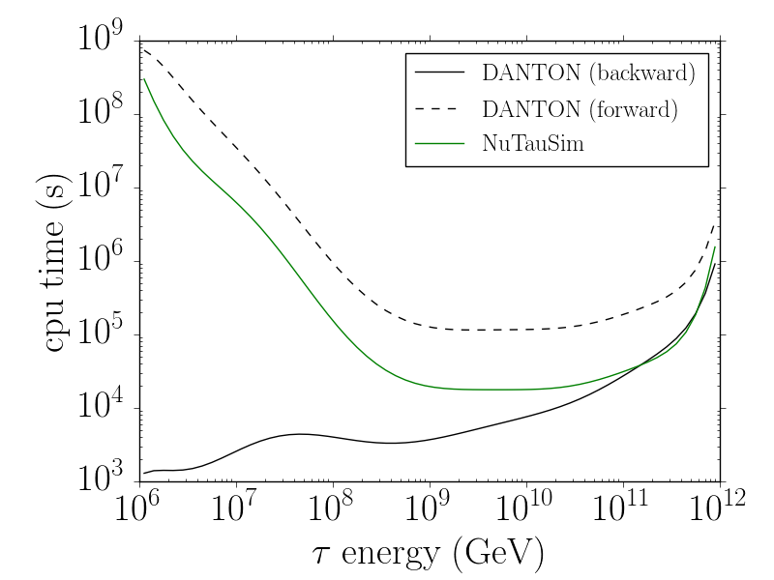
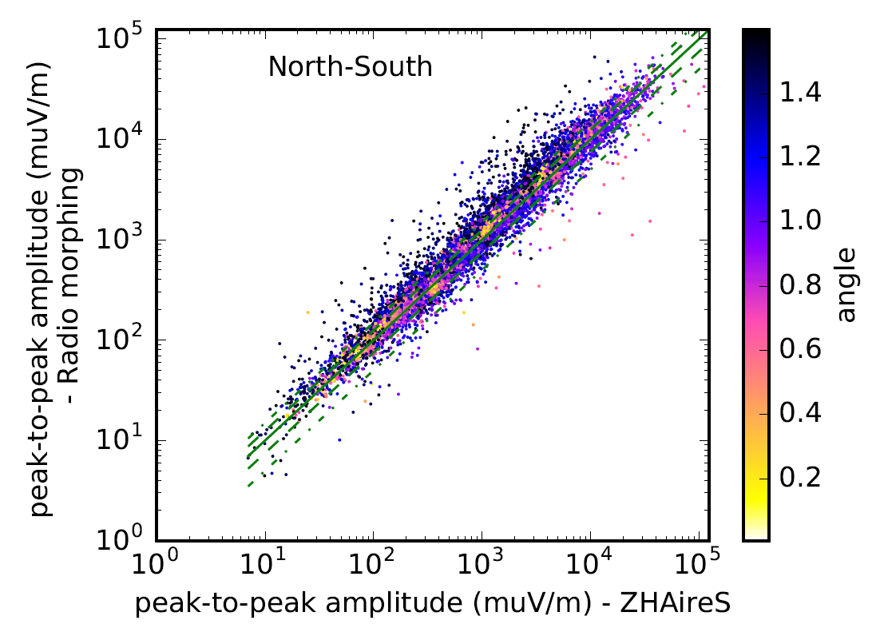
GRAND neutrino sensitivity computation
End-to-end custom simulation
A- DANTON: ν→τ decay
backward MC over realistic topography.
V. Niess and OMH, 1810.01978
B- RadioMorphing: semi-analytical computation of the air-shower-induced Efield transient signal.
A. Zilles et al., Astropart. Phys 114 (2020), 1809.04912

Slide 6
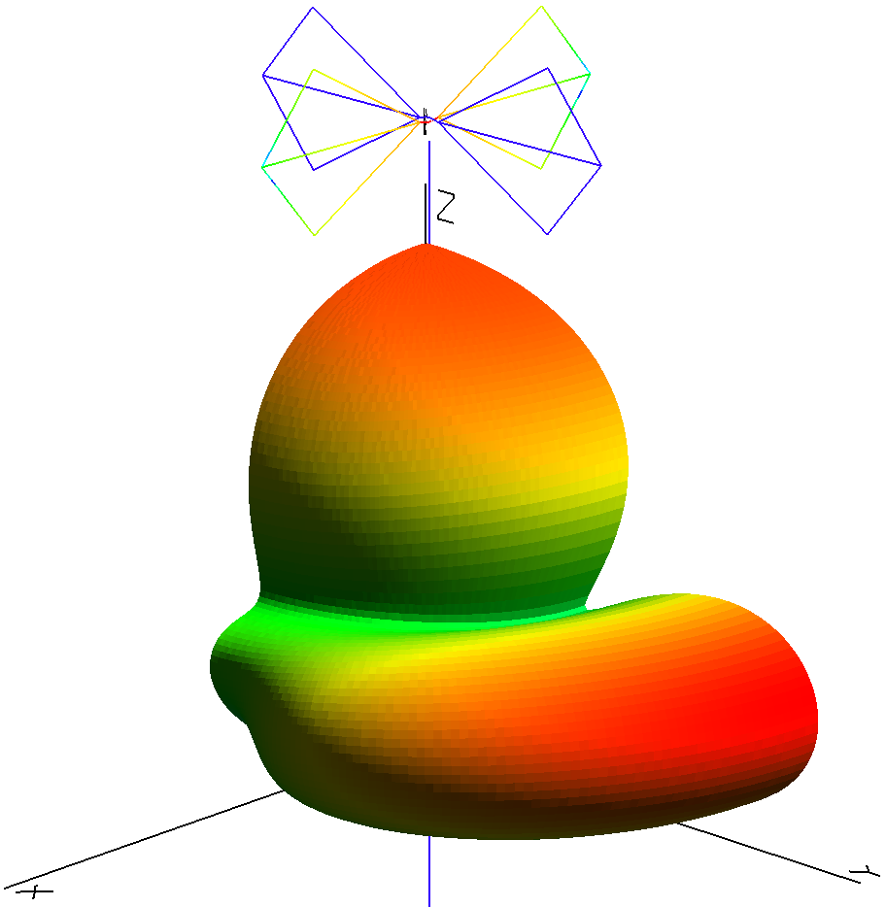
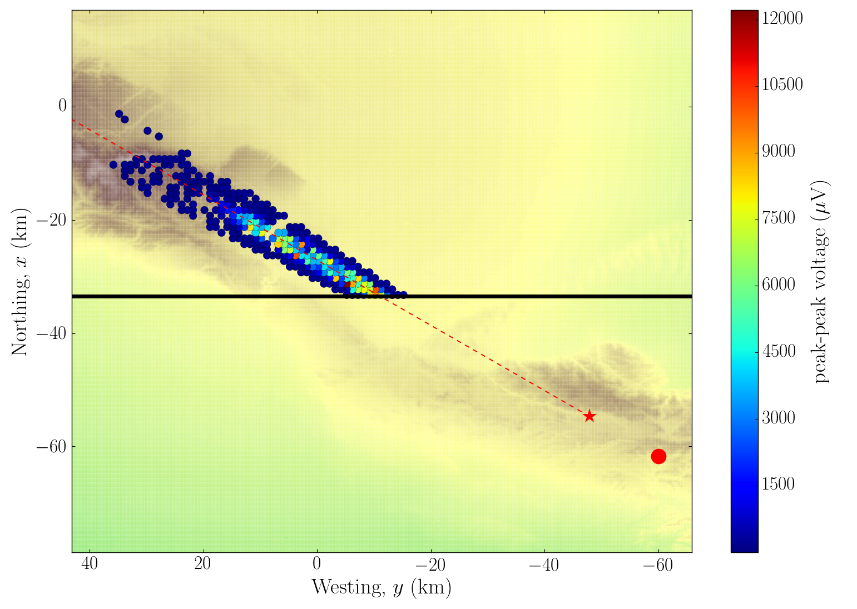
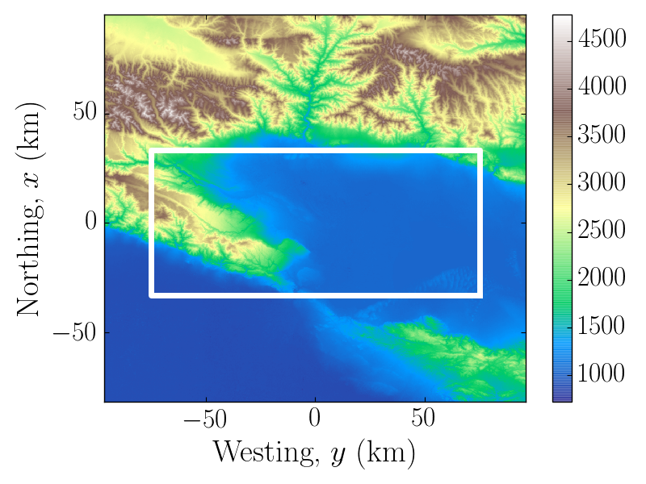
GRAND neutrino sensitivity computation
End-to-end custom simulation
C- Antenna response:
HORIZONANTENNA, h=5m, f = 50-200MHz, optimized for very inclined trajectories [Decoene #233, Balagopal #184]. Response simulated in NEC4.
E_{ν} = 2 10¹⁹eV; θ = 93°
Trigged antennas
10 000km²
HotSpot1
Antenna gain (NEC4)
τ decay
D- Layout: 10’000 antennas with 1km step square grid on area with favorable topography (TianShan mountains, China).
Trigger: Peak-peak voltage > 2σ_{noise} (agressive) or 5σ_{noise} (conservative) & cluster of 5 neighbouring antennas.
ν CC interaction

Slide 7
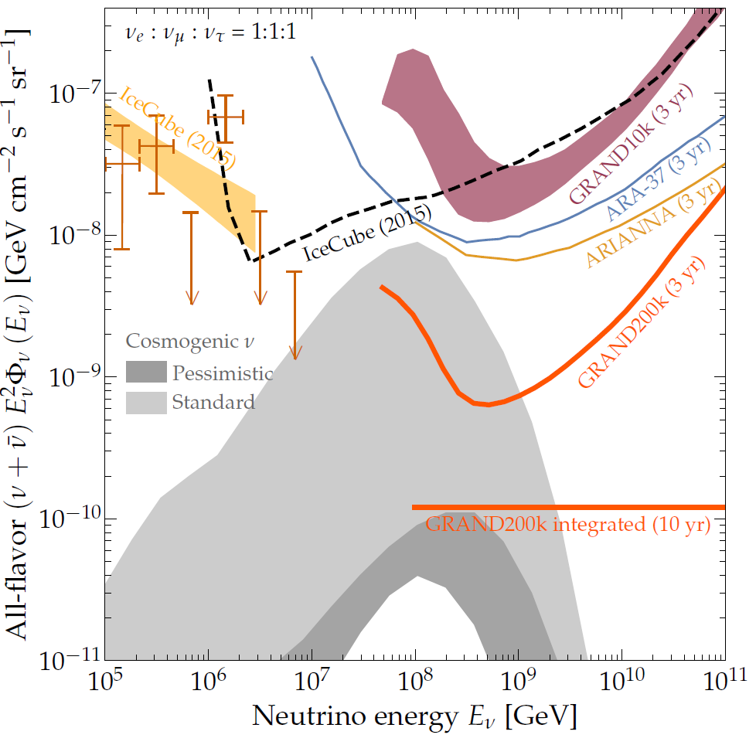
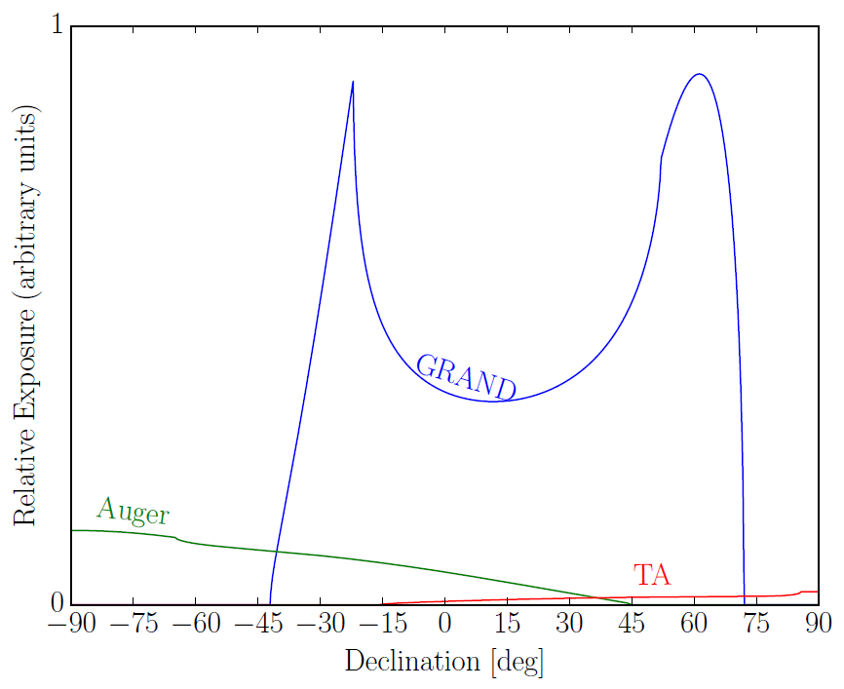
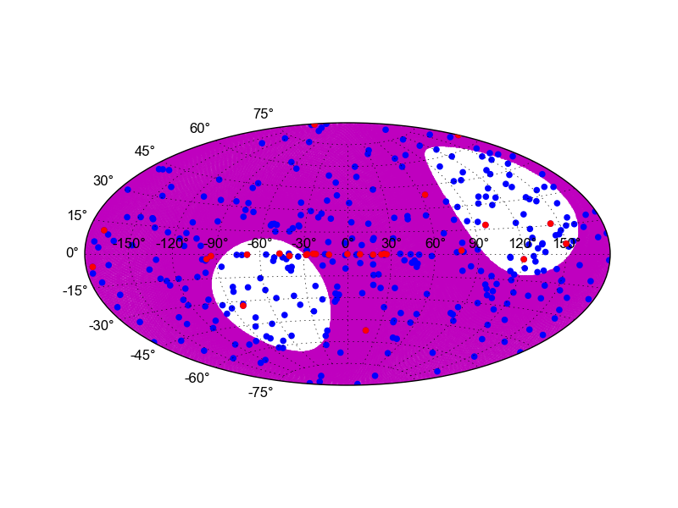
GRAND science case
GRAND10k (10’000 km²) in IceCube2015 range.
Aiming at ~20 such subarrays deployed on areas with favorable topography at different locations in the world ➔ GRAND200k (20x10 000 km²)
Sensitivity of full array good enough for GRAND to detect cosmogenic neutrinos for standard hypothesis
1h visibility
(for one subarray @ 43°N)
Assuming all subarrays @ same spot (43°N)
24h visibility
(for one subarray@ 43°N)
200 000km² detection area makes GRAND a powerfull tool for UHECR physics (X_{max}?)
Also radio-astronomy: FRBs & EoR (?)

Slide 8
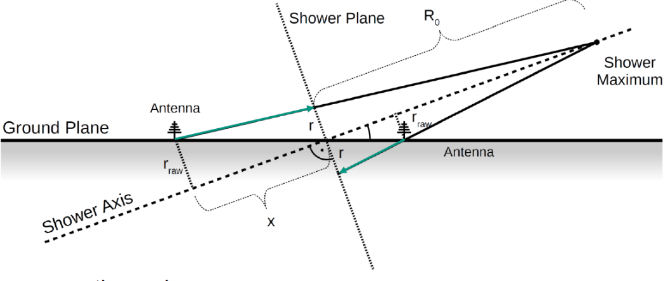
EVENT RECONSTRUCTION FOR VERY INCLINED SHOWERS
Main issue: additional assymetries for very inclined showers cannot be ignored (different shower age, different atmospheric conditions, …)
Dedicated reconstruction methods are necessary!
Taken from Huege #294
e.g. Huege # 294, Gottowick#274, Marshalkina et al, 1812.03724
Additional challenge for X_{max}: very distant location requires improved determination on geometric position (km) for given reslution ΔX (g/cm²)
θ = 60°: 700g/cm² ⬄ 10.5km from ground; 800g/cm² ⬄ 8.6km
➔ ΔX = 100 g/cm² ⬄ 20% on geometric position
θ = 84°: 700g/cm² ⬄ 122km from ground; 800g/cm² ⬄ 115.5km
➔ ΔX = 100 g/cm² ⬄ 6% on geometric position

Slide 9
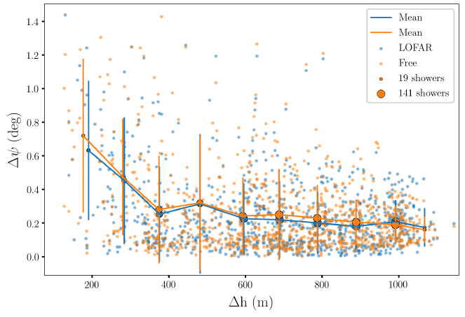
EVENT RECONSTRUCTION FOR VERY INCLINED SHOWERS
Yet, standard methods do not perform that bad, thanks to very large footprint & topography... Encouraging!
Angular resolution:
Test with neutrino-induced showers illuminating GRAND like toy-model array (slant array of fixed slope)
Hyperbolic fit [Corstanje et al. 1404.3907]
GPS resolution & noise included
Δψ ~ 0.2° for Δh>400m
X_{max}:
applying LOFAR method [Buitink et al. 1408.7001] yields ~40g/cm² (provided E and x_{core} known)
V. Decoene

Slide 10
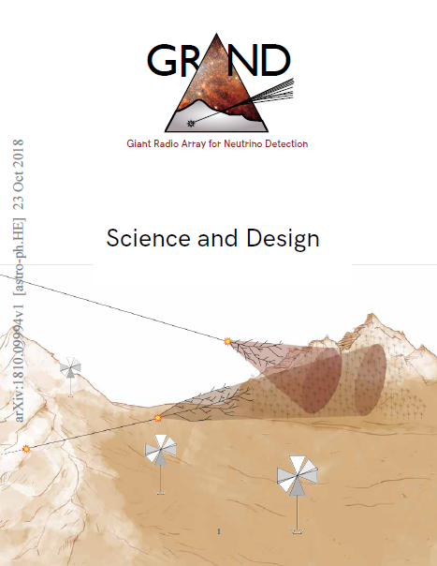
MoU in preparation between
IAP
KIT
Nanjing U.
NAOC
Penn State U.
Radboud U. (Nijmegen)
U. Federal Rio
astro-ph/1810.09994
J. Alvarez-Muniz et al,
Sci. China-Phys. Mech. Astron.
63, 219501 (2020)

Slide 11
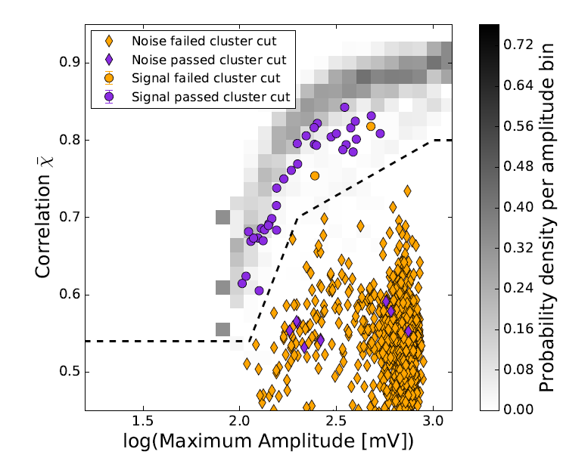
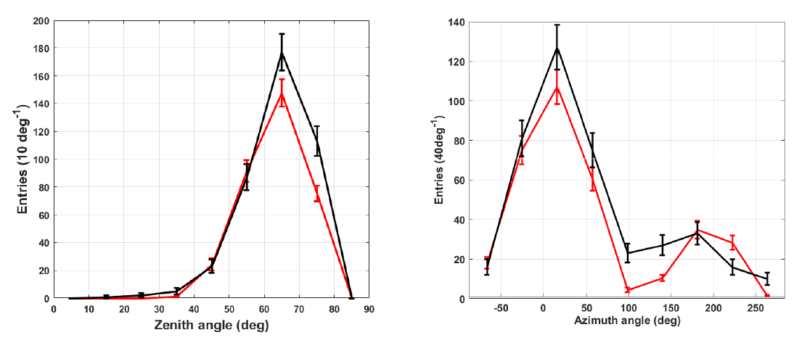
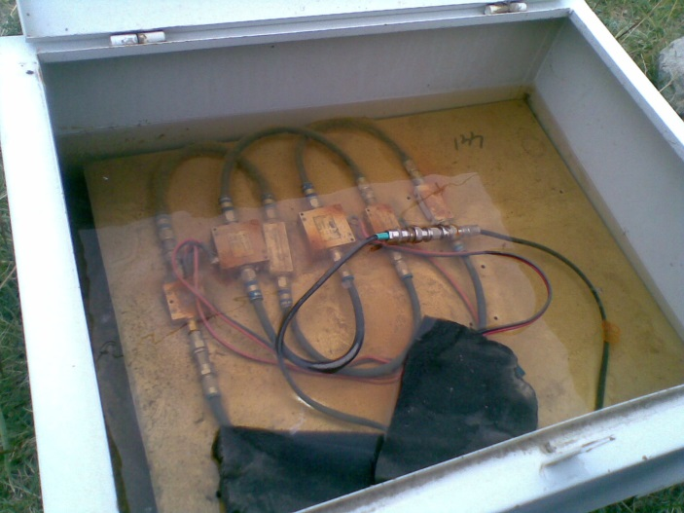
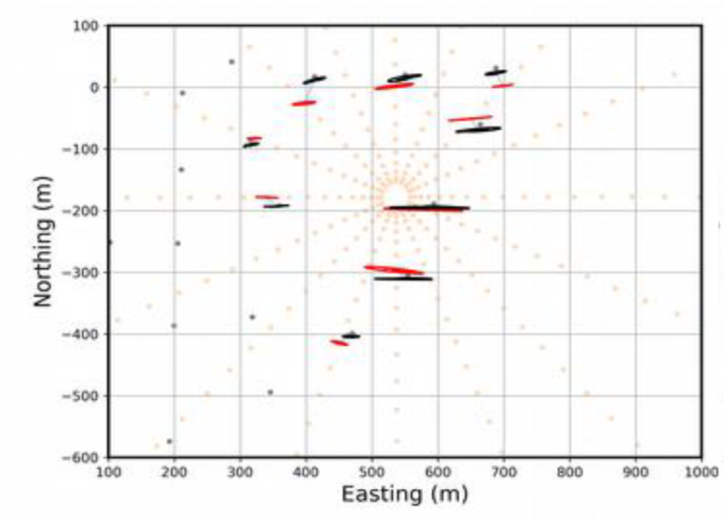
autonomous radio detection
The TREND experiment, seed for GRAND
(2009-2013-2018, Tianshan mountains, China)
50 self-triggered antennas in a very remote & quiet site.
Still: radio coinc rate = tens of Hz while EAS rate: ~20/day
BUT distinct EAS & background signatures allow for excellent discrimination
Efficiency ε = 3% but well understood: hardware issues explain 90% of it.
Possible air shower signal
ARIANNA 1612.04473, Nelles#366
Autonomous radio detection is a technical issue, not a Physics one.
D. Charrier et al., Astropart. Phys 110 (2019)
S. Le Coz et al., ICRC2017
TREND data
Simulated EAS
Certain background signal
Experimental polarisation
Simulated EAS
CODALEMA, 1710.02487

Slide 12
GRAND DESIGN
What is set:
large & sparse subarrays of self-triggered radio antennas working in ~50-200MHz.
Beyond that:
?

Slide 13
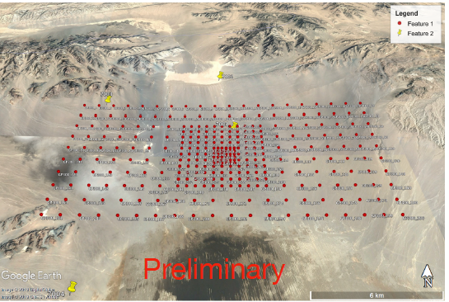
GRAND DESIGN
Array design will be informed by GRANDProto300 [Decoene #233], a testbench for GRAND:
Trigger & data transfer [Hughes#917, Kostunin#319, Führer+ 1809.01934, Erdman+ 1901.04079]
Unit design? (Antenna design? Stations a la ARA/ARIANNA?)
Also carefull watch at other efforts in the field (AUGER, etc).
GP300
Deployment to be completed in 2021
Ultimately, layout of a given GRAND subarray may be adjusted depending on location, topography & science case.
GRAND subarrays *may* be complemented by independant detectors (phased radio-arrays [Wissel#1033], fluorescence detector [Fujii #259],…)

Slide 14
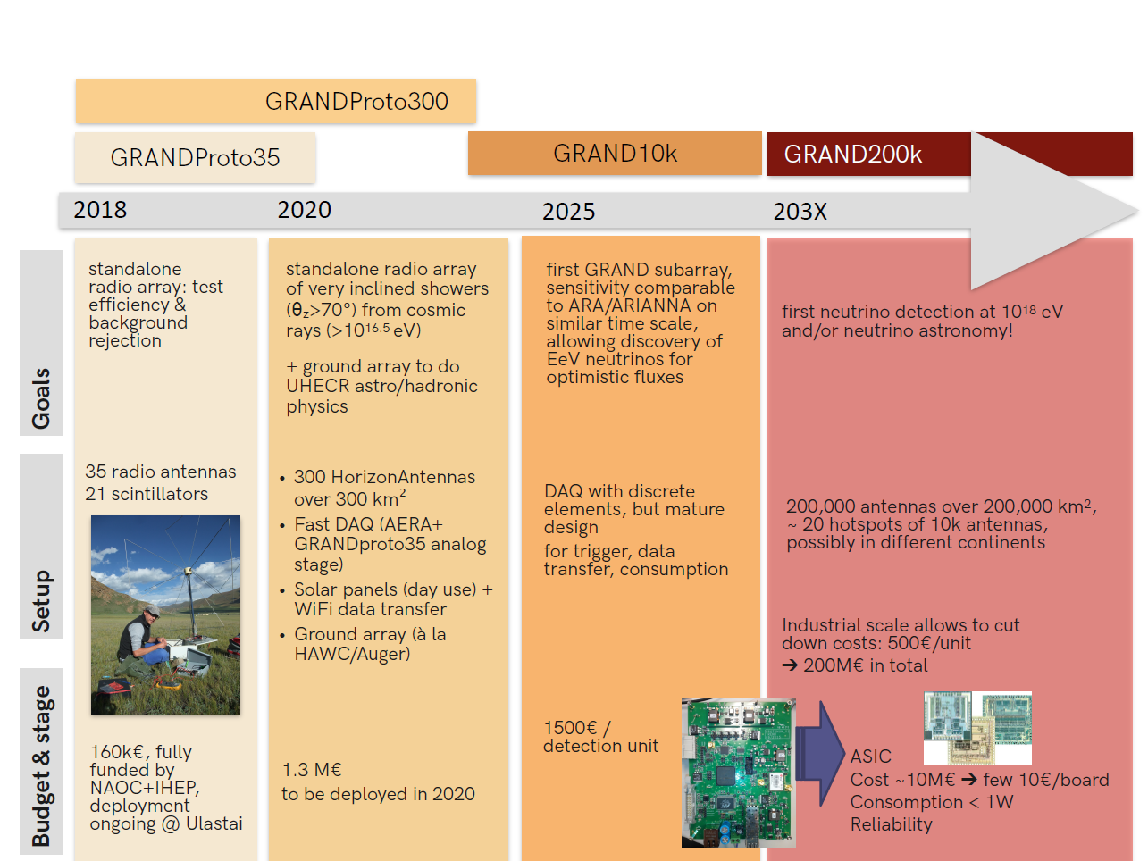

Slide 15
CONCLUSION
GRAND is a proposal for a giant network of 20x10’000 radio antennas, to be deployed around the world in 203x.
Simulations indicate sensitivity to neutrinos, FoV & angular resolution sufficient to allow for UHE neutrino astronomy.
GRANDProto300 (2021+) will be a testbench for GRAND. This + other efforts in the field will allow to define the final design for GRAND array (& reconstruction methods) in a few years from now.

