Slide 1
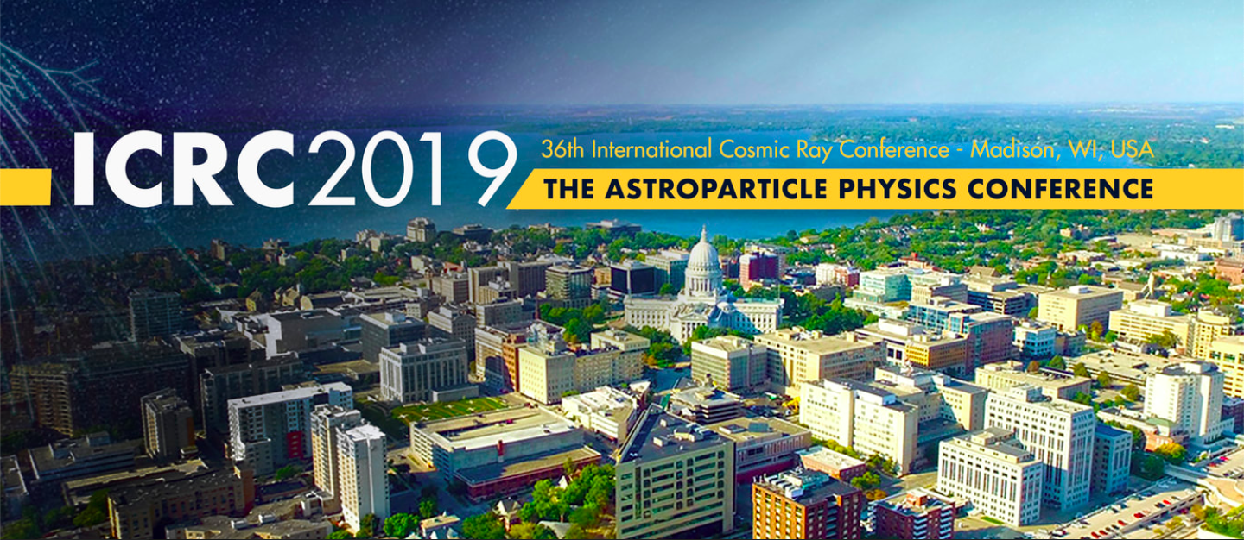
Welcome to
25 July - 1 August

Slide 2
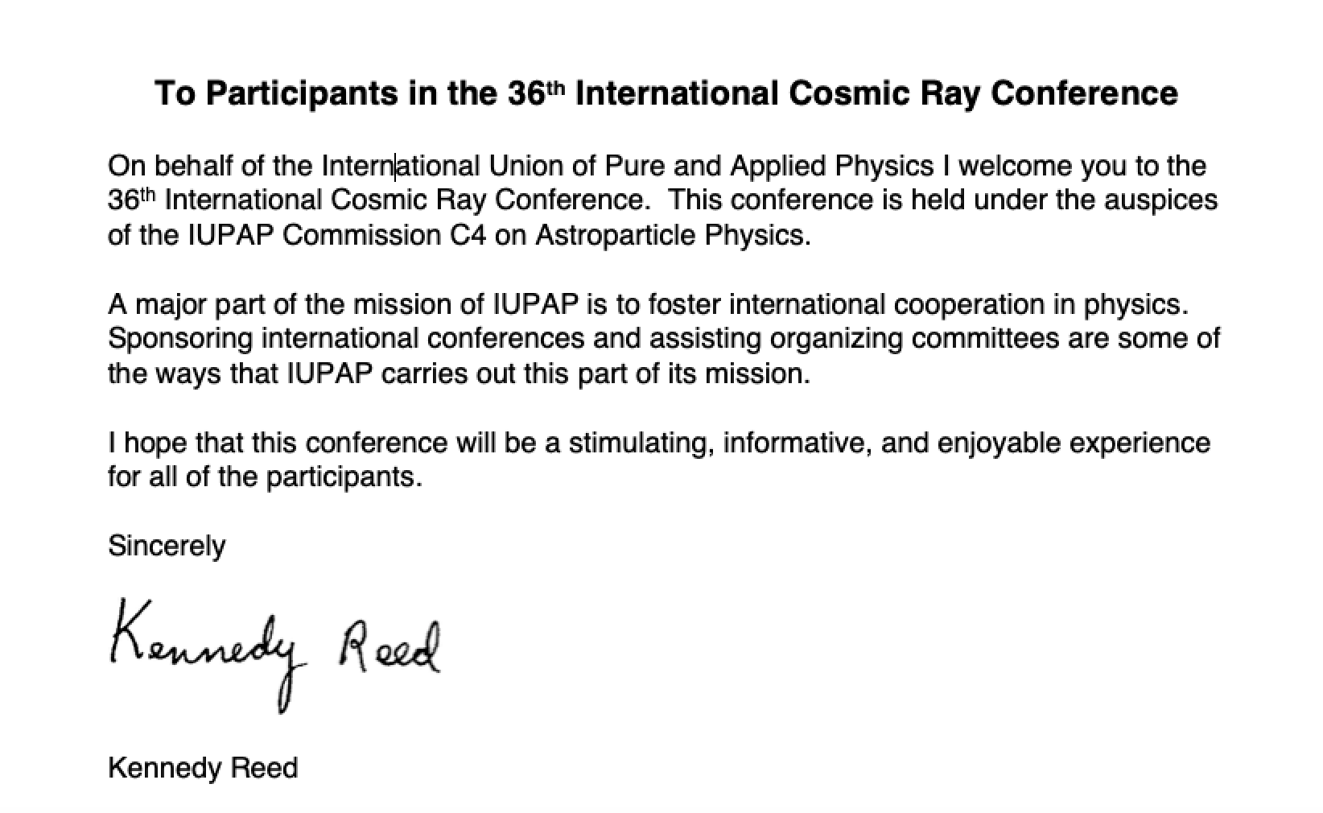
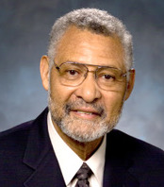
International Union of Pure and Applied Physics
Message from the President, IUPAP
Prof. Kennedy J. Reed
Lawrence Livermore, USA
President, IUPAP

Slide 3
The IUPAP Mission:
To stimulate and promote international cooperation in physics
To foster free circulation of scientists
To foster the preparation and the publication of tables of physical constants and promote international agreements on use of symbols, units, nomenclature and standards
To encourage research and education
To help in the application of physics toward solving problems of concern to humanity
To sponsor suitable international meetings and to assist organizing committees

Slide 4
IUPAP Commissions
C1: Commission on Finance
C2: Commission on Symbols, Units, Nomenclature, Atomic masses and Fundamental Constants
C3: Statistical Physics
C4: Astroparticle Physics
C5: Low Temperature Physics
C6: Biological Physics
C8: Semiconductors
C9: Magnetism
C10: Structure and Dynamics of Condensed Matter
C11: Particles and Fields
C12: Nuclear Physics
C13: Physics for Development
C14: Physics Education
C15: Atomic, Molecular, and Optical Physics
C16: Plasma Physics
C17: Laser Physics and Photonics
C18: Mathematical Physics
C19: Astrophysics
C20: Computational Physics
Previously known as the Commission on Cosmic Rays established by the IUPAP in 1947 to promote the exchange of information and views among the members of the international scientific community in the general field of Astroparticle Physics.
Astroparticle physics is a new multidisciplinary field of research that deals with the study of particles coming from the Universe.
Cosmic rays
Gamma rays
Solar and heliospheric physics
Neutrinos
Dark matter

Slide 5
IUPAP Commissions & Working Groups
C1: Commission on Finance
C2: Commission on Symbols, Units, Nomenclature, Atomic masses and Fundamental Constants
C3: Statistical Physics
C4: Astroparticle Physics
C5: Low Temperature Physics
C6: Biological Physics
C8: Semiconductors
C9: Magnetism
C10: Structure and Dynamics of Condensed Matter
C11: Particles and Fields
C12: Nuclear Physics
C13: Physics for Development
C14: Physics Education
C15: Atomic, Molecular, and Optical Physics
C16: Plasma Physics
C17: Laser Physics and Photonics
C18: Mathematical Physics
C19: Astrophysics
C20: Computational Physics
AC.1: International Commission for Optics
AC.2: International Commission for General Relativity and Gravitation
AC.3: International Commission on Acoustics
AC.4: International Commission on Medical Physics
WG.1: International Committee for Future Accelerators
WG.2: Communication in Physics
WG.5: Women in Physics
WG.7: International Committee on Ultrahigh Intensity Lasers
WG.9: International Cooperation in Nuclear Physics (ICNP)
WG.10: Astroparticle Physics International Committee (ApPIC)
WG.11: Gravitational Wave International Committee (GWIC)
WG.12: Energy

Slide 6
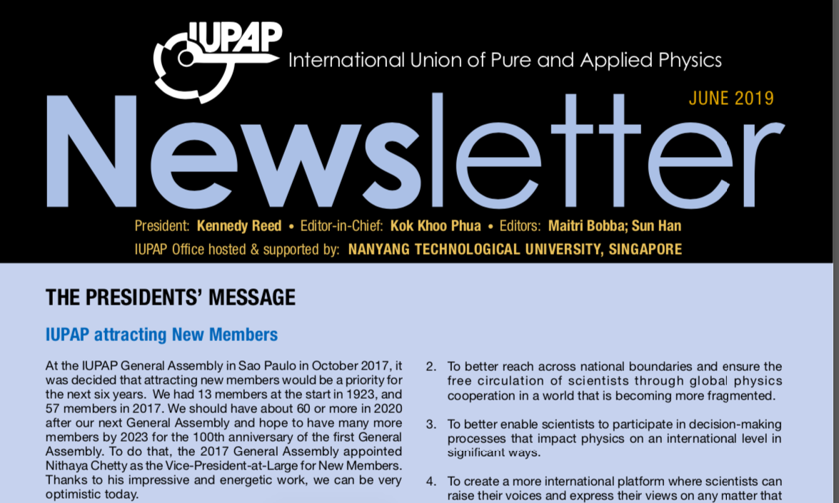
Web: http://iupap.org/newsletter

Slide 7
IUPAP C4 Commission (2018-2020)
(Int. Advisory Committee for ICRC)
Sunil K. Gupta (Chair)
Adri Burger (Vice-Chair)
Jörg R. Hörandel (Secretary)
Zhen Cao
Yoshitaka Itow
Ralph Engel
Mikhail Panasyuk
Ilya Usoskin
Joakim Edsjö
Christina M. Cohen
Fiorenza Donato
Veronique Van Elewyck
Seon-Hee Seo
Michael Kachelriess
Associate members:
Imre Bartos
Steven Barwick
Takaaki Kajita
C4 Mandate
To promote the exchange of information and views among the members of the international scientific community in the general field of Cosmic Ray Physics including:
The nature and characteristics of the electromagnetic, particle and other radiation present in the cosmos;
The theory and models concerning the origin of this radiation;
Non-accelerator high energy physics;
The specialized technologies necessary in the field and their application

Slide 8
The ICRC is the main conference organized and supported by C4
Several other topical international conferences supported by C4 include
TAUP, IDM, ISVHECRI, TeVPA, VLVnT, …
Topics: cosmic rays, gamma rays, neutrinos, solar & heliosphere, dark matter, underground experiments, …
Good News: Proceedings of ICRCs since 1947 available on ADS http://ads.harvard.edu/pubs/icrc_proceedings.html
Special thanks to Jörg Hörandel, Donna Thompson et al. at ADS, Alan Watson for sharing old volumes and Sijbrand de Jong, CERN

Slide 9
Some statistics on ICRC 2019
857 Participants
39 countries
1062 abstracts received
410 oral talks (39%) + 652 posters (61%)
34 plenary talks + 1 public lecture
5 parallel sessions, Time = 15 minutes
International Scientific Program Committees tasked with the responsibility to recommend (1) plenary topics including speakers for highlight, review and rapporteur talks, (2) oral / poster presentations etc.
New: Live Streaming of Plenary sessions
https://events7.mediasite.com/Mediasite/Catalog/catalogs/icrc2019live
Notes:
25 July: 3 HT, 69 O (6 O, 6 O, 6 O, 6 O, 5 O and 8 O, 8 O, 8 O, 8 O, 8 O)
26 July: 2 RT, 3 HT, 70 O (6 O, 6 O, 6 O, 6 O, 6 O and 8 O, 8 O, 8 O, 8 O, 8 O), 1 PU
27 July: 2 RT, 3 HT, 70 O (6 O, 6 O, 6 O, 6 O, 6 O and 8 O, 8 O, 8 O, 8 O, 8 O)
29 July: 2 RT, 3 HT, 70 O (6 O, 6 O, 6 O, 6 O, 6 O and 8 O, 8 O, 8 O, 8 O, 8 O)
30 July: 2 RT, 3 HT, 70 O (6 O, 6 O, 6 O, 6 O, 6 O and 8 O, 8 O, 8 O, 8 O, 8 O)
31 July: 2 RT, 3 HT, 68 O (6 O, 6 O, 6 O, 6 O, 5 O and 7 O, 8 O, 8 O, 8 O, 8 O)
1 Aug: 7 RP
Oral: 417 Poster: 701
Plenary: 29

Slide 10
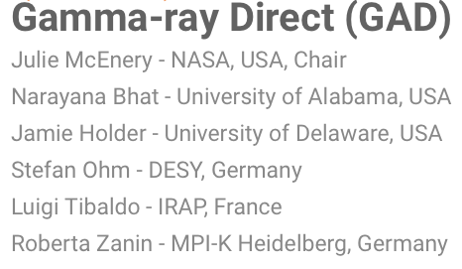
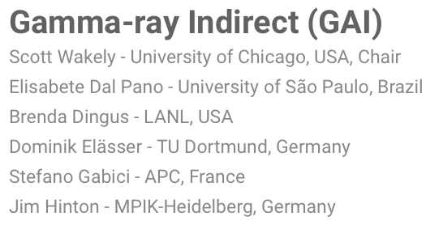
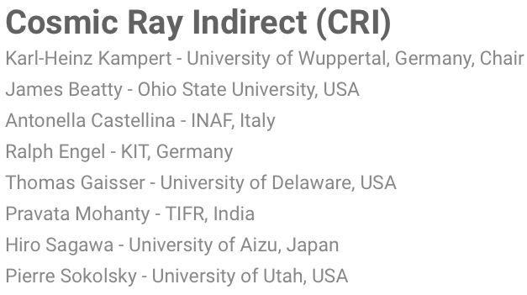
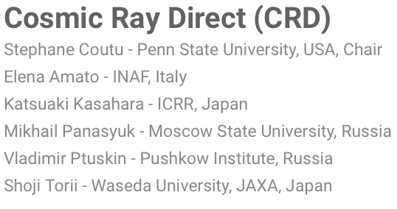
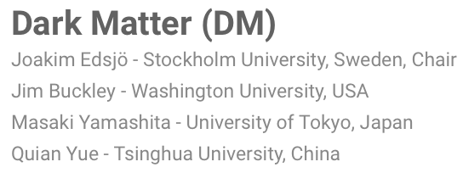
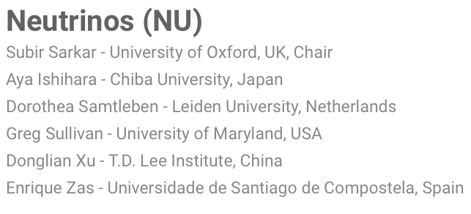
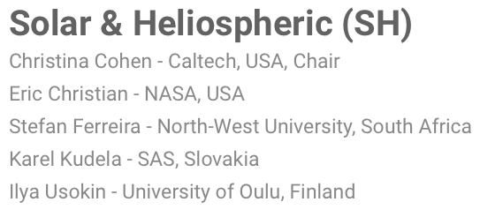
International Scientific Program Committee (ISPC)

Slide 11
Local Organizing Committee (LOC)
Albrecht Karle University of Wisconsin-Madison (Chair​)
Paolo Desiati University of Wisconsin-Madison
Michael DuVernois University of Wisconsin-Madison
Cary Forest University of Wisconsin-Madison
Thomas K. Gaisser University of Delaware
Francis Halzen University of Wisconsin-Madison
Kael Hanson University of Wisconsin-Madison
Jim Madsen University of Wisconsin-River Falls
Angela Olinto University of Chicago
Kim Palladino University of Wisconsin-Madison
Justin Vandenbroucke University of Wisconsin-Madison
Scott Wakely University of Chicago
Ellen Zweibel University of Wisconsin-Madison

Slide 12
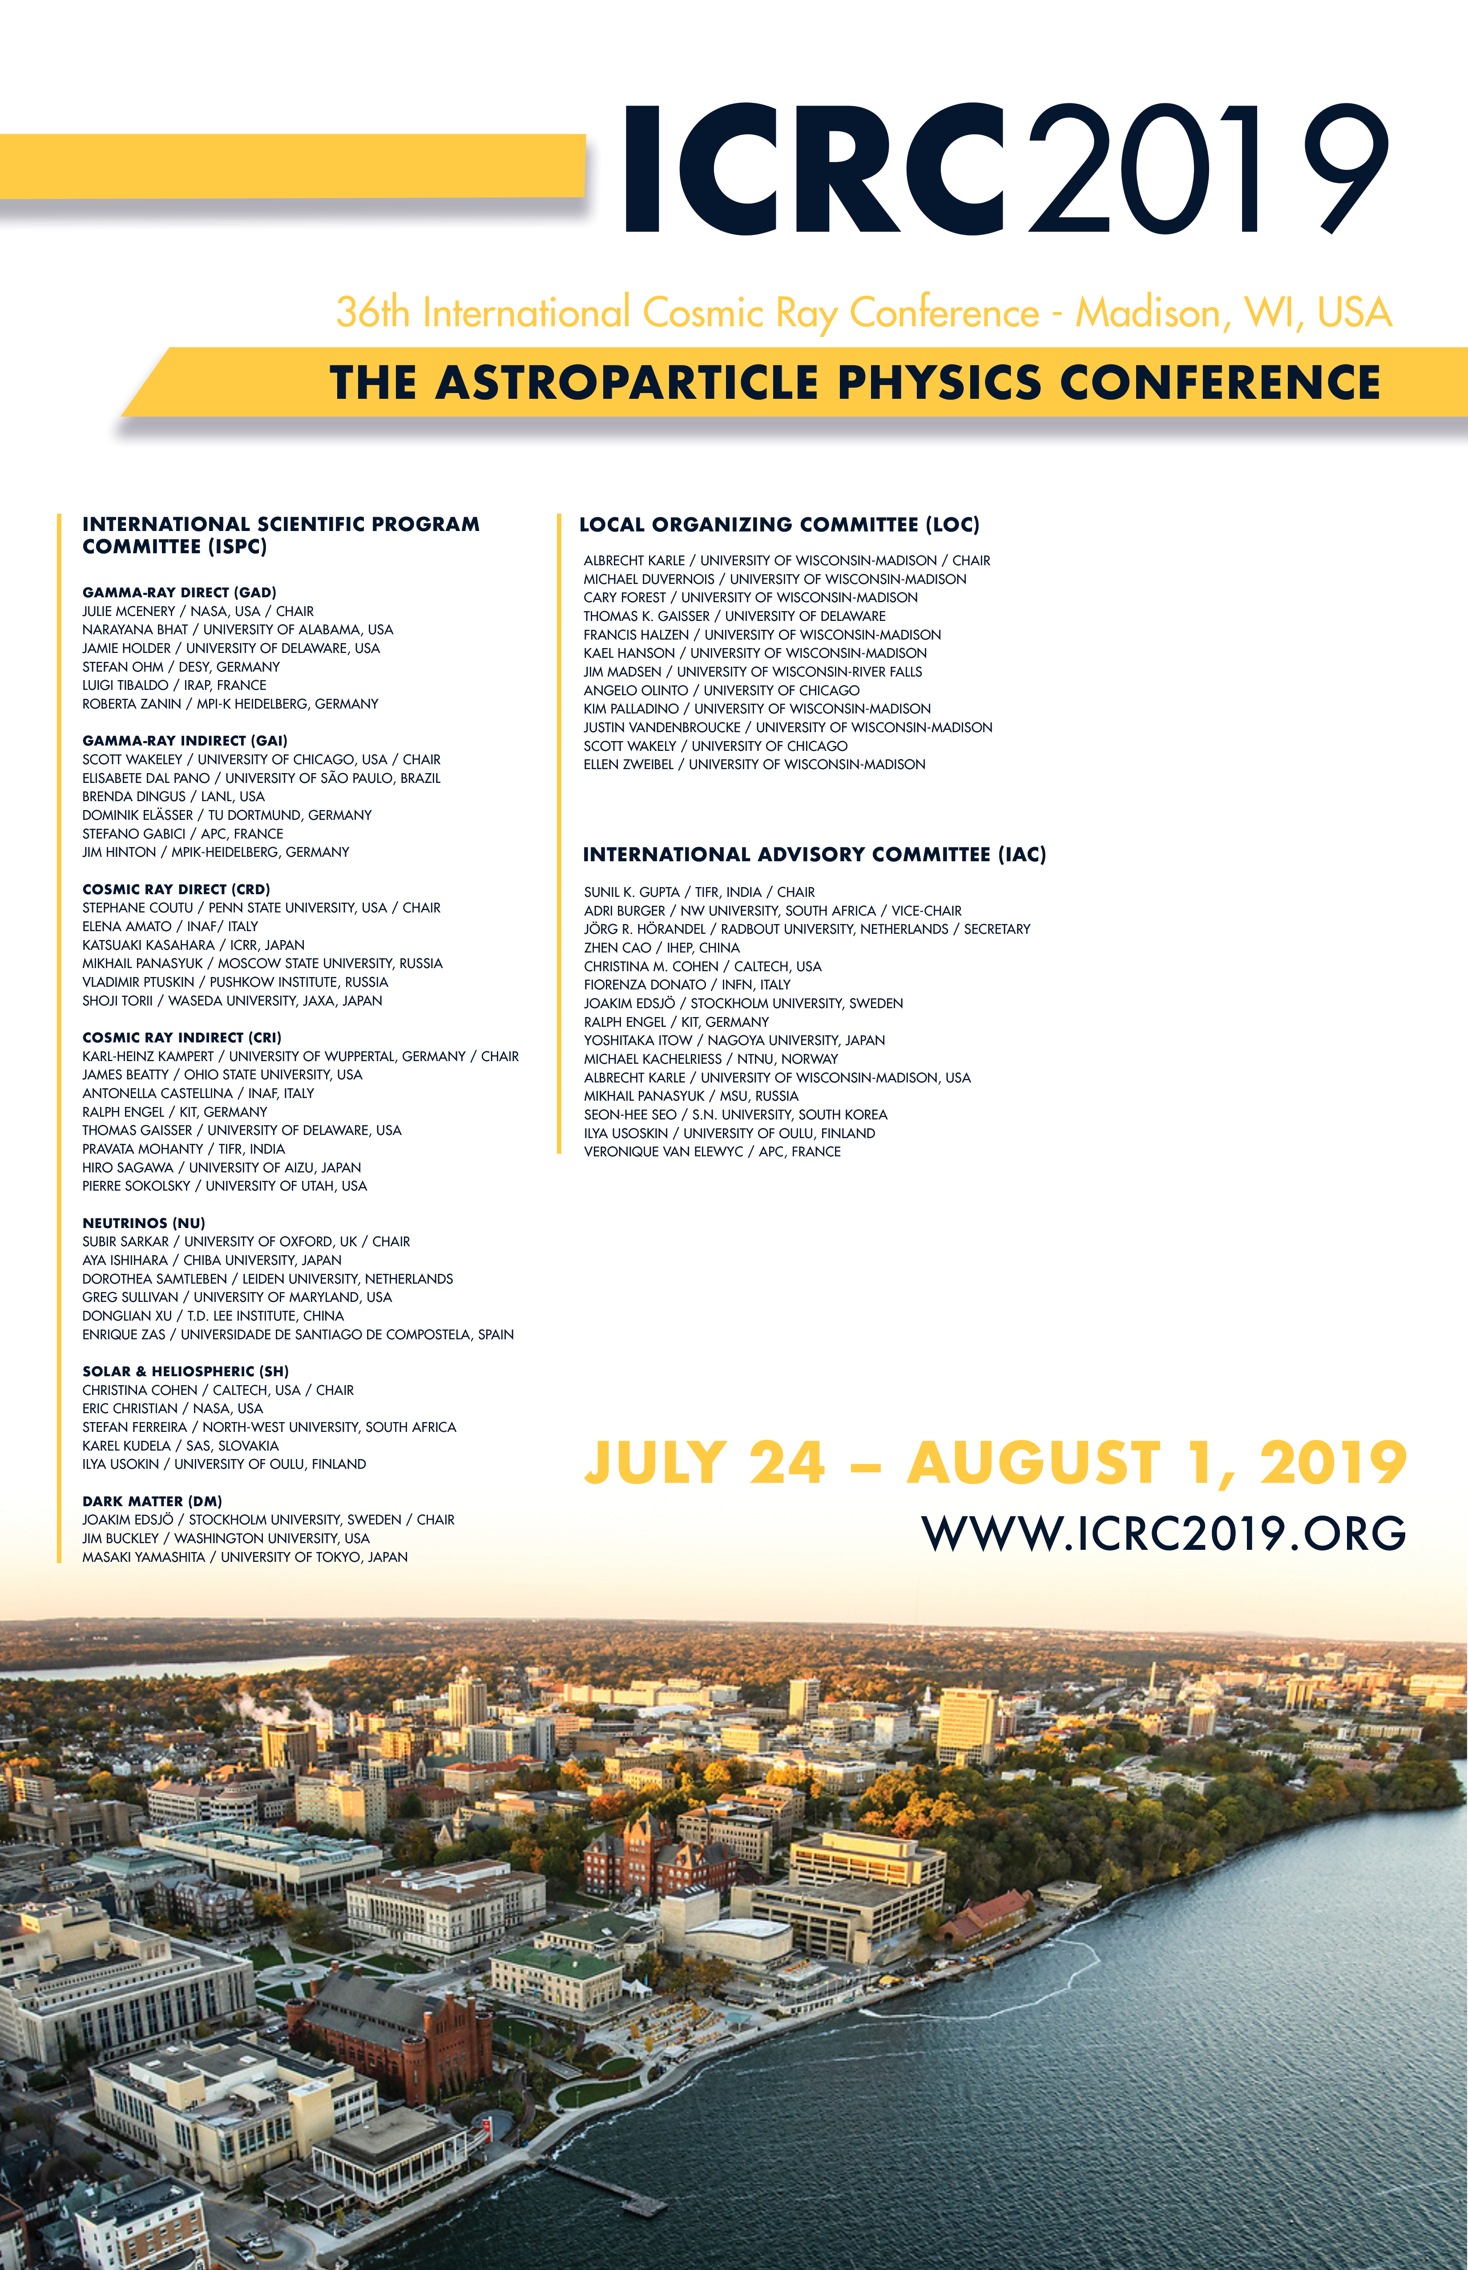
On behalf of the participants and C4 I thank the members of ISPC and LOC for managing a very tough and complex task very efficiently

Slide 13
Awards & Prizes
IUPAP Young Scientist Awards (2 Awards)
Shakti P. Duggal Award
O’Ceallaigh Medal
Yodh Prize
IUPAP-TIFR Homi Bhabha Medal and Prize A large number of exceptional nominations were received !

Slide 14
Best Poster Awards
Eligibility
All posters will be eligible for this award provided they meet the requirements below: * The presentations should consist of well-prepared visual materials about the research * It requires the author be registered at the Conference and in attendance to present details and answer questions during the first and last hour of the designated session time.
Nature of the Award * One award for each of the three sessions consists of a 300 € cash prize and a certificate * The awards will be given during the closing session. Thus, it is recommended that the author may attend that session
Selection Process
Poster Award Committees will review all the posters
Selections will be based on the level of the research, quality of the poster, and clarity of the presentation.
A maximum of three awards will be given; one for each of the three poster sessions

Slide 15
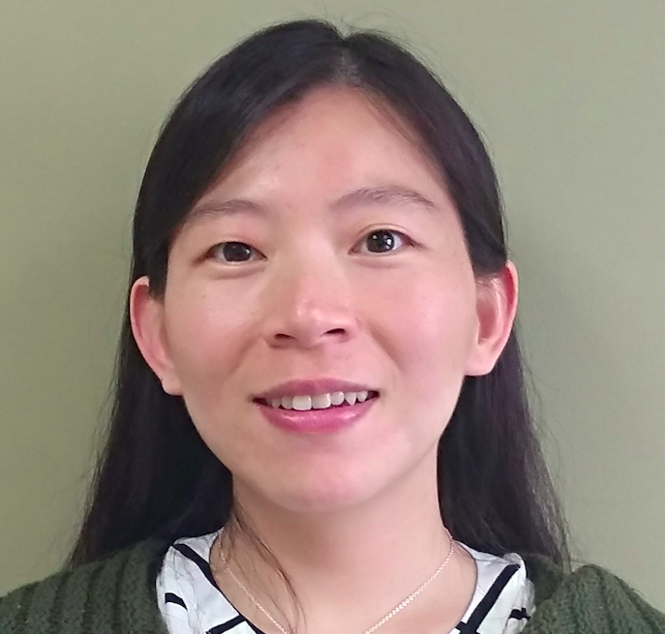
IUPAP Young Scientist Award
… to recognize the research by young scientists
in a field of interest of the IUPAP C4 Commission
(max 8 yrs of research experience after PhD, excl. career interruptions)
Dr. Siyao Xu, Hubble Fellow, University of Wisconsin, Madison
for "fundamental theoretical contributions to Astroparticle Physics that reveal profound connections among diverse phenomena”
Honors: Francis Halzen
Presenter: Sunil Gupta

Slide 16
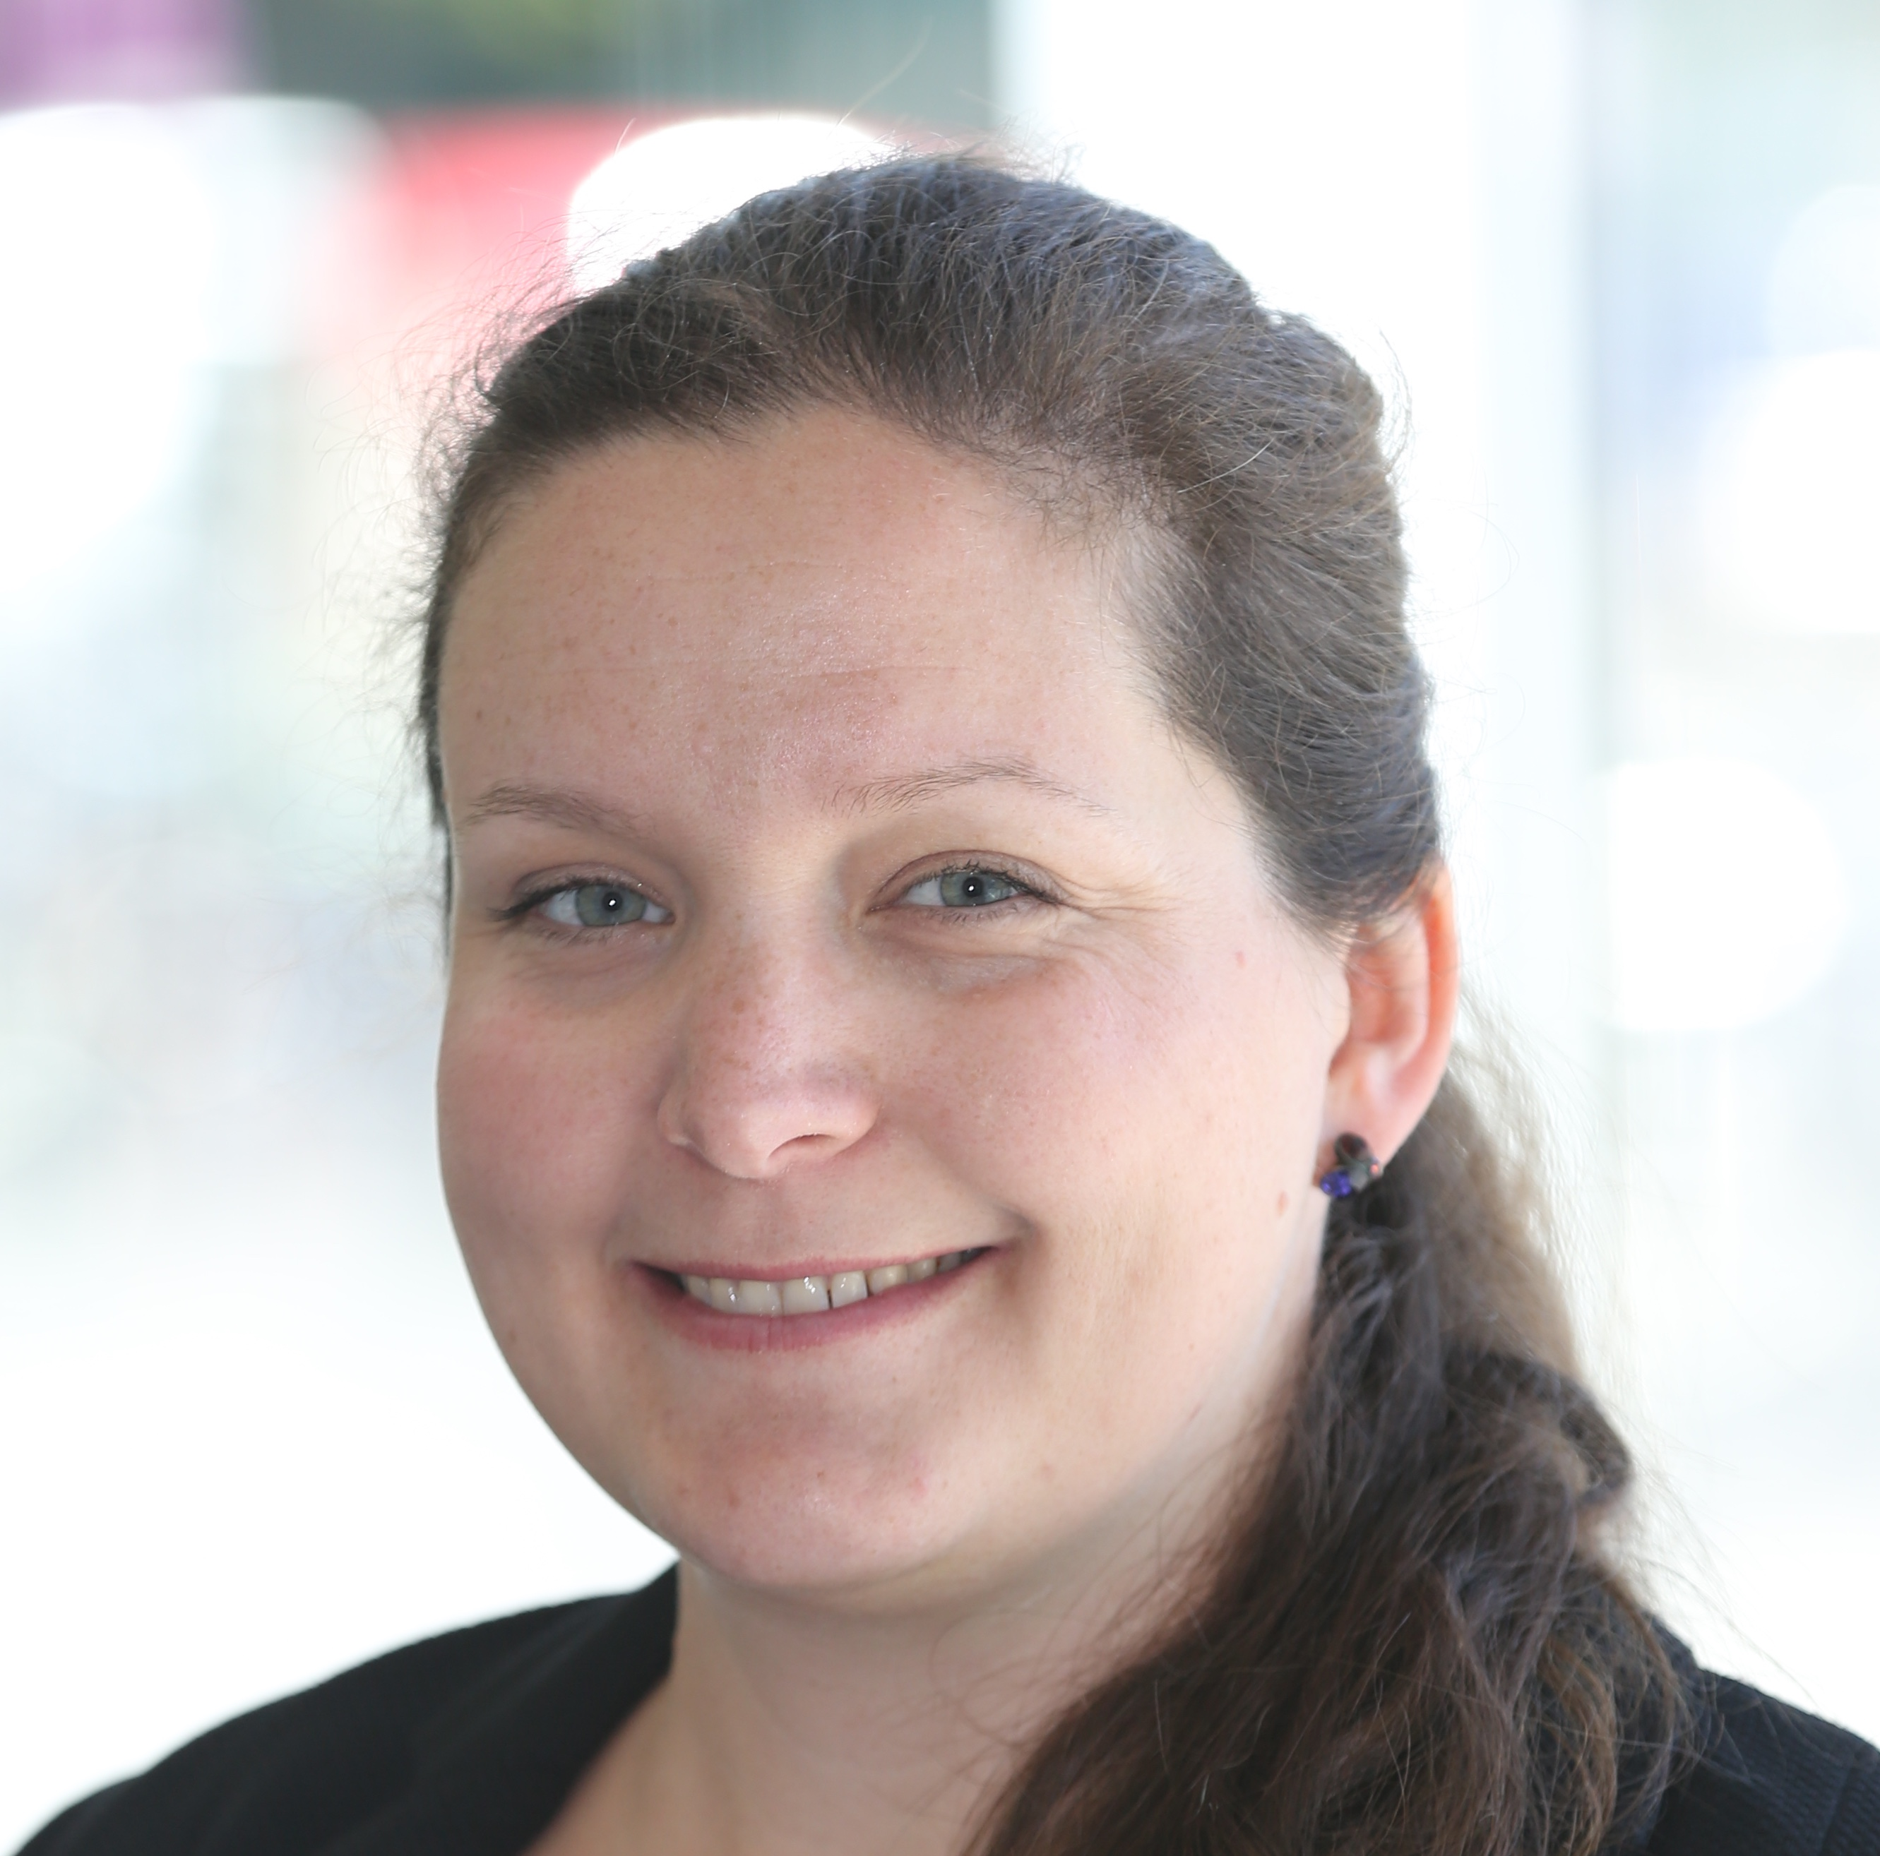
IUPAP Young Scientist Award
… to recognize the research by young scientists
in a field of interest of the IUPAP C4 Commission
(max 8 yrs of research experience after PhD, excl. career interruptions)
Prof. Anna Nelles, DESY Zeuthen, Friedrich Alexander University
Erlangen Nuremberg
for “outstanding contributions to the radio detection of cosmic rays and neutrinos”
Honors: Jörg Hörandel
Presenter: Sunil Gupta

Slide 17
Shakti P. Duggal Award
... to recognize outstanding work by a young scientist in the field of Cosmic Ray Physics, including Astroparticle Physics
Prof. Irene Temborra, Niels Bohr Institute, University of Copenhagen
for “pioneering work in advancing our understanding of the role of neutrinos in cosmic accelerators”
Honors: Fiorenza Donato
Presenter: Thomas Gaisser

Slide 18
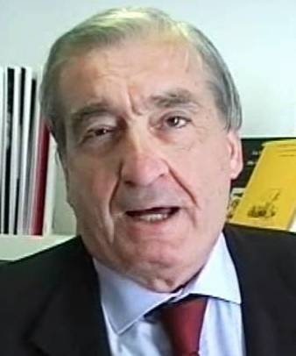
O’Ceallaigh Medal
... to recognize significant contributions to the field of Astroparticle Physics over an extended career
Prof. Piergiorgio Picozza, University of Rome Tor Vergata and INFN
for “Outstanding contributions in nucleating and nurturing space based missions including PAMELA and AGILE missions”
Honors: Marco Ricci
Presenter: Luke Drury

Slide 19
Kanwal & Gaurang Yodh Prize
... to recognize a scientist whose research career has made substantial contributions to understanding in the field of Cosmic Rays. The research should have had a major impact in the field
Prof. Francis Halzen, University of Wisconsin, Madison
for “his leadership and landmark contributions that cleared the path for the emergence of neutrino astronomy”
Honors: Steve Barwick
Presenters: Jaya Yodh & Sunil Gupta

Slide 20
Homi Bhabha Medal and Prize
... to an active scientist who has made distinguished contributions in the field of high energy cosmic ray physics and astro-particle physics over an extended academic career
Prof. Takaaki Kajita, Director ICRR, and University of Tokyo
for “Outstanding contributions to Cosmic Ray physics including path breaking work in neutrino physics”
Message from Director, TIFR
Honors: Subir Sarkar
Presenter: Sunil Gupta

Slide 22
Homi Bhabha Medal and Prize
... to an active scientist who has made distinguished contributions in the field of high energy cosmic ray physics and astro-particle physics over an extended academic career
Prof. Takaaki Kajita, Director ICRR, and University of Tokyo
for “Outstanding contributions to Cosmic Ray physics including path breaking work in neutrino physics”
Message from Director, TIFR
Honors: Subir Sarkar
Presenter: Sunil Gupta

Slide 23
We remember the colleagues we lost in the last two years who have made immense contributions to our field and enriched our lives as mentors and friends

Slide 24
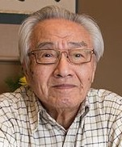
Shuji Fukui
1923-2018
Nagoya University, Japan

Slide 25
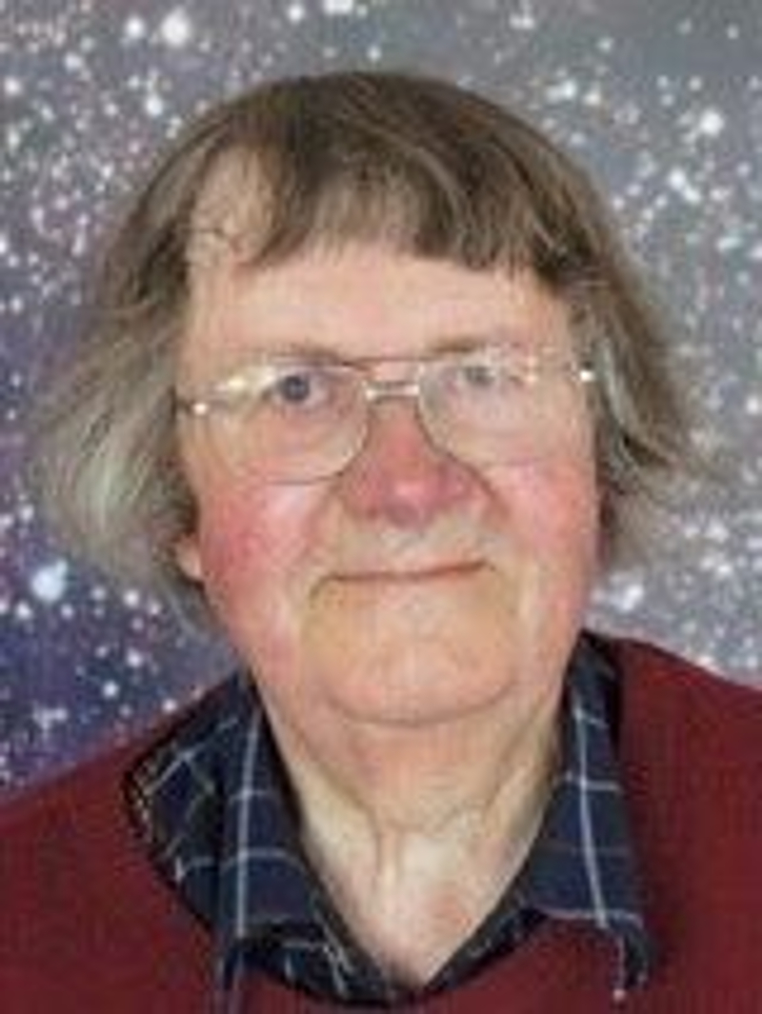
Michael Hillas
1932-2017
Leeds University, U.K.

Slide 26
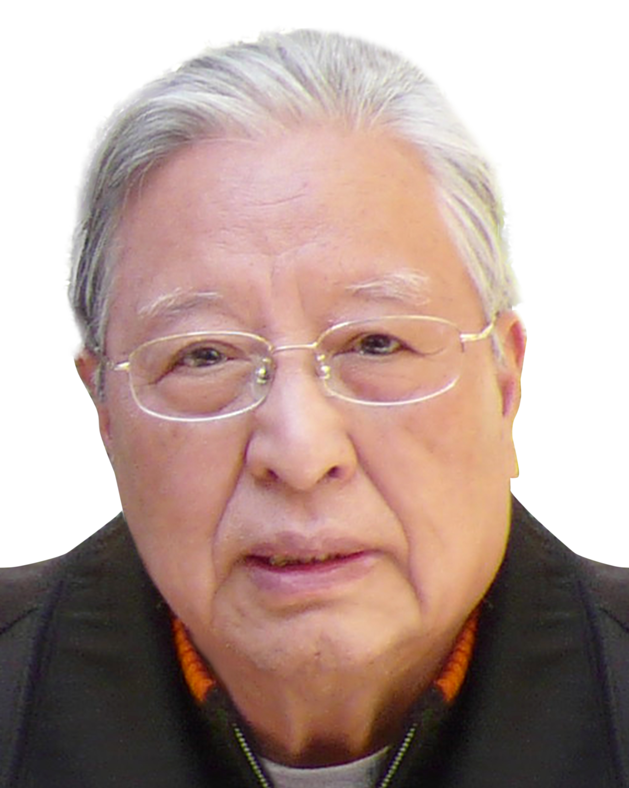
Anxiang Huo
1930-2017
Institute of High Energy Physics, China

Slide 27
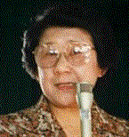
Yoshiko Kamiya
1921-2016
Nagoya University, Japan

Slide 28
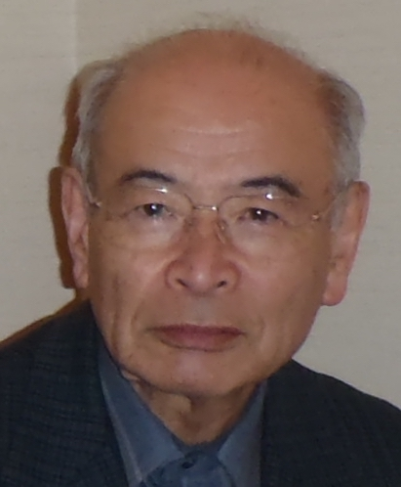
Tatsunosuke Kaneko
1931-2018
Okayama University, Japan

Slide 29
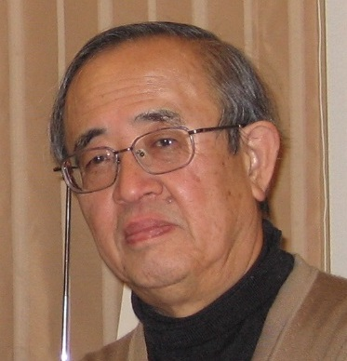
Setsuo Kawaguchi
1941-2017
Hirosaki University, Japan

Slide 30
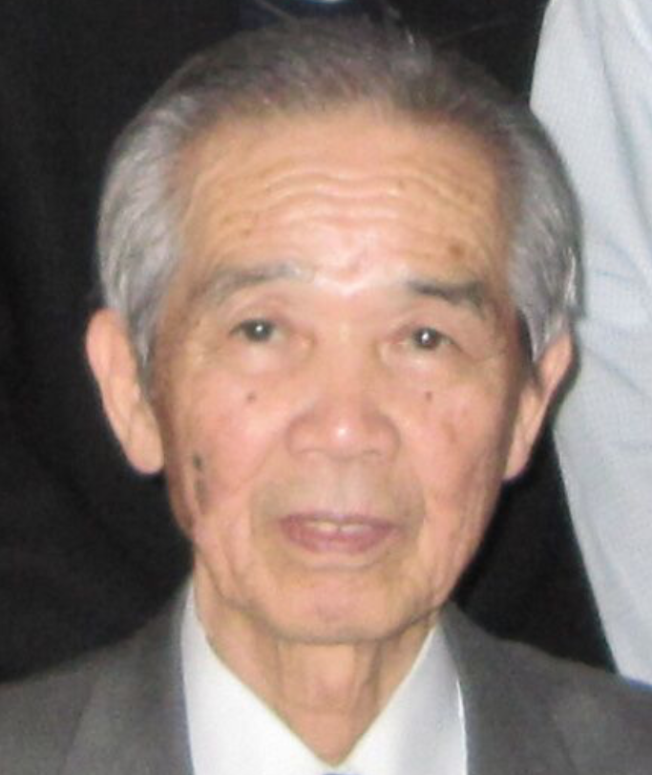
Keizo Kobayakawa
1931-2018
Kobe University, Japan

Slide 31
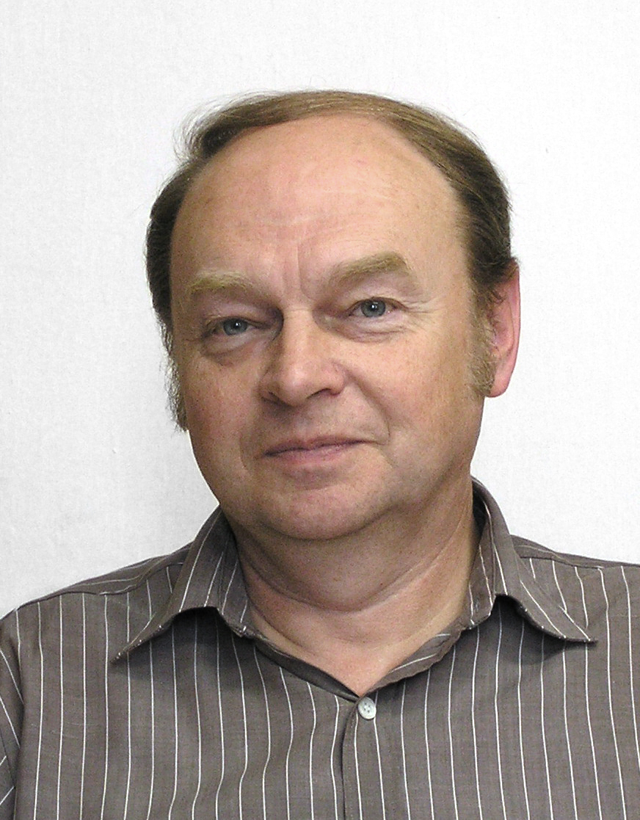
Karel Kudela
1946-2019
Slovak Academy Kosice, Slovakia

Slide 32
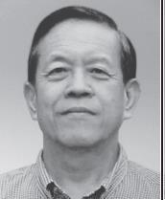
Shigenori Miyamoto
1931-2017
Osaka University, Japan

Slide 33
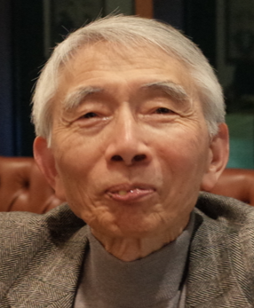
Kohei Mizutani
1941-2017
Saitama University, Japan

Slide 34
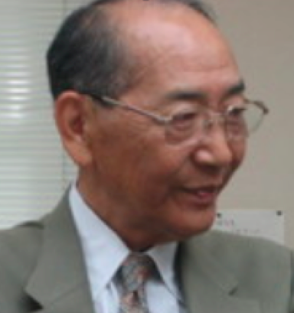
Kiyoshi Niu
1925-2017
Nagoya University, Japan

Slide 35
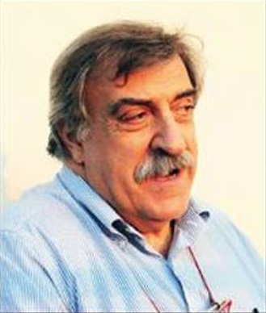
Giorgio Palumbo
1939-2018
Bologna University, Italy

Slide 36
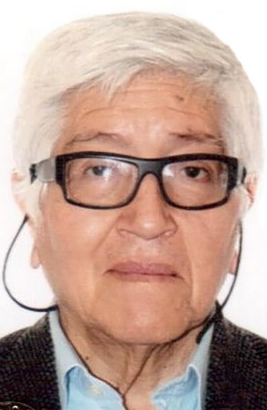
Oscar Saavedra San Martin
1940-2018
Torino University, Italy

Slide 37
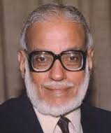
M.G.K. Menon
1928-2016
Tata Institute of Fundamental Research, India

Slide 38
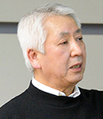
Koichiro Nishikawa
1949-2018
KEK, Japan

Slide 39
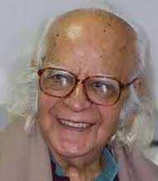
Yash Pal
1926-2017
Tata Institute of Fundamental Research, India

Slide 40
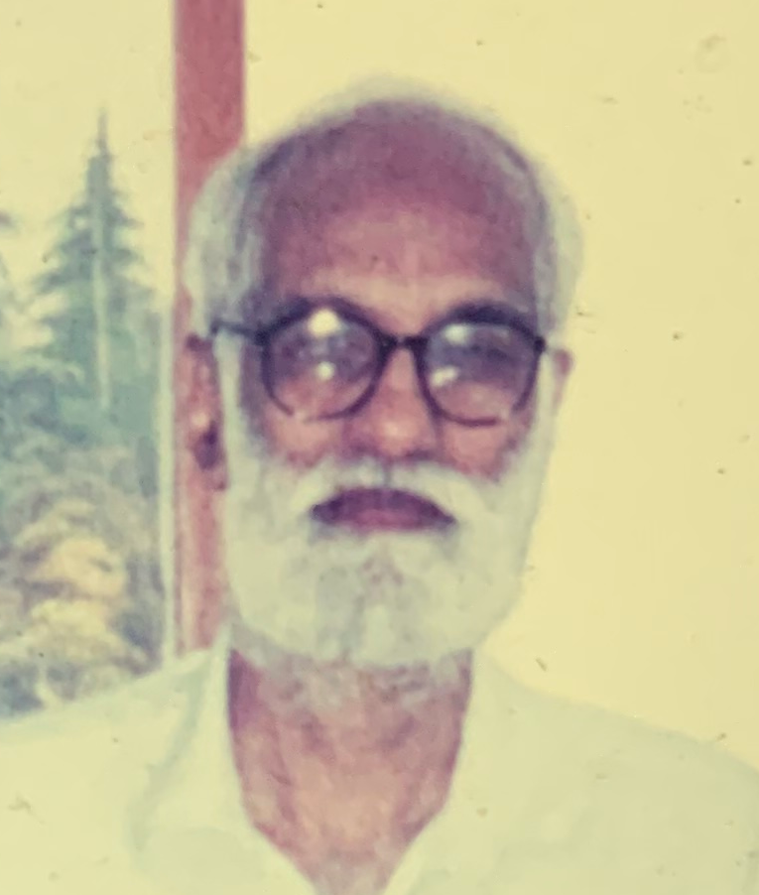
K. Sivaprasad
1941-2018
Tata Institute of Fundamental Research, India

Slide 41
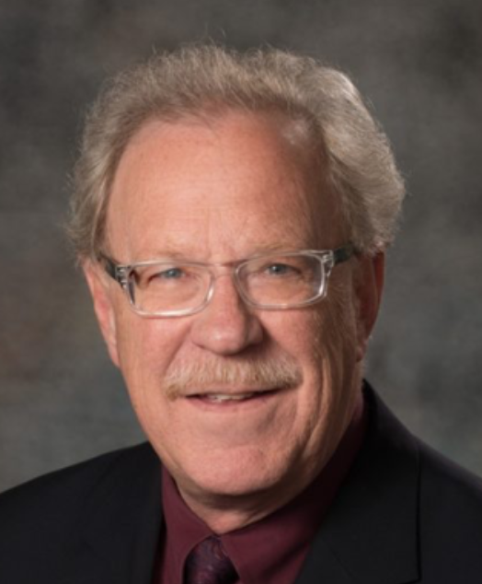
Greg Snow
1954-2019
University of Nebraska-Lincoln, USA

Slide 42
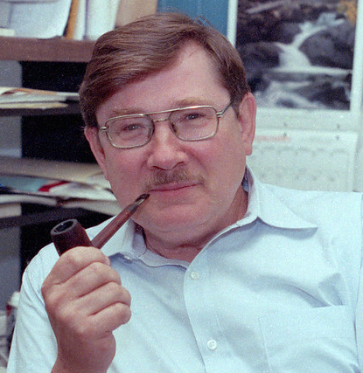
Robert E. Streitmatter
1942-2018
NASA / GSFC, USA

Slide 43
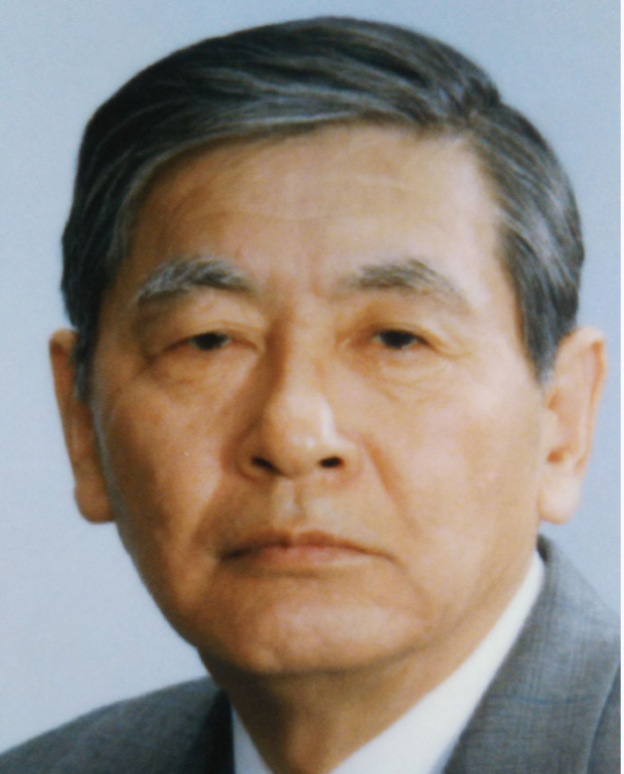
Goro Tanahashi
1927-2017
ICRR, Tokyo University, Japan

Slide 44
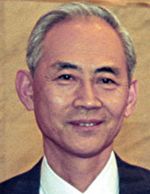
Yasuo Tanaka
1931-2018
ISAS, Japan

Slide 45
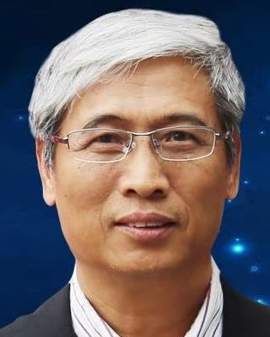
Huanyu Wang
1954-2018
Institute of High Energy Physics, China

Slide 46
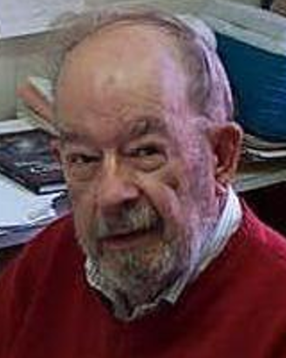
William R. Webber
1929-2018
New Mexico State University, USA

Slide 47
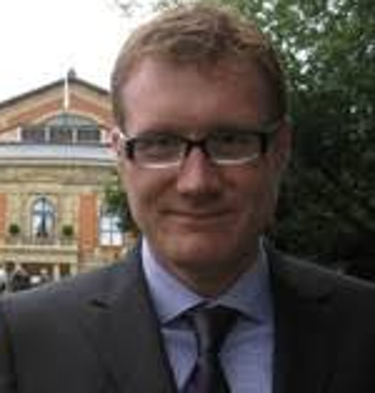
Stefan Westerhoff
1967-2018
University of Wisconsin, USA

Slide 48
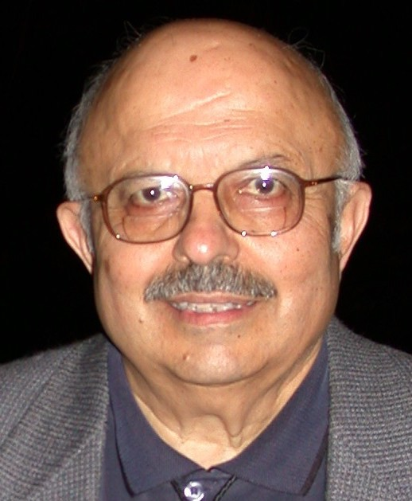
Gaurang B. Yodh
1928-2019
University of California Irvine, USA

Slide 49
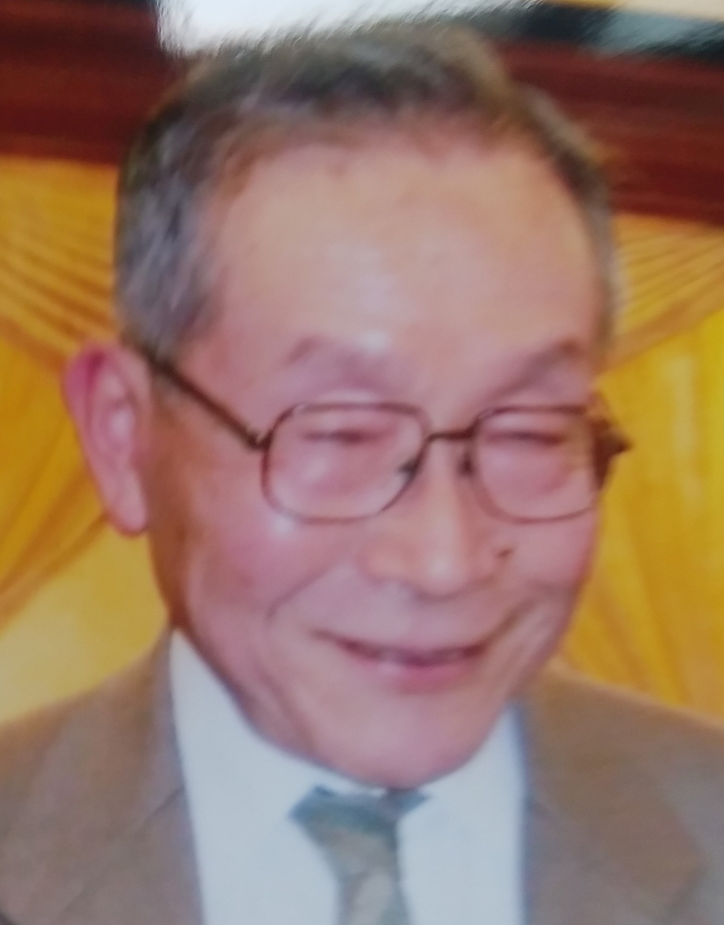
Kei Yokoi
1931-2019
Aoyama University, Japan

Slide 50
Thank You

