Slide 1
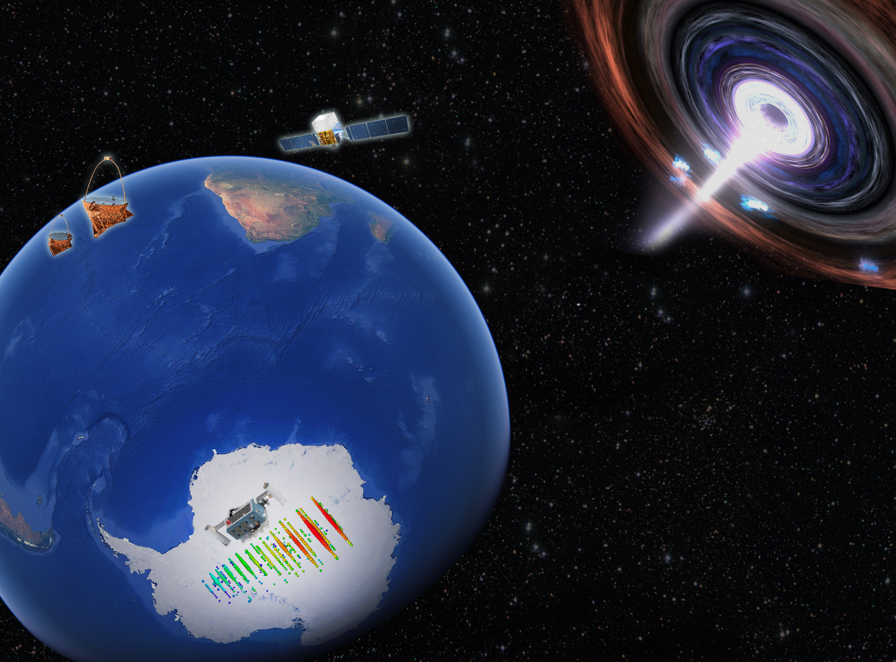


IceCube as a Multi-messenger Follow-up Observatory for Astrophysical Transients
Justin Vandenbroucke, Alex Pizzuto, Kevin Meagher
(University of Wisconsin)
International Cosmic Ray Conference
Madison, Wisconsin, July 30, 2019

Slide 2
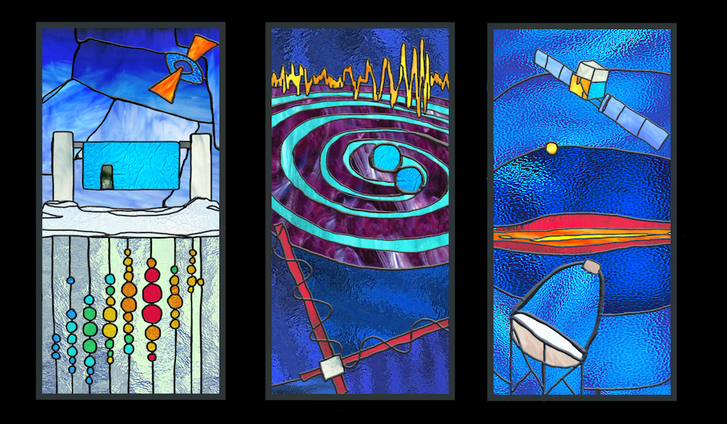
Motivation
First high-energy astrophysical neutrino source (and first extragalactic cosmic-ray source) identified thanks to IceCube alerting other observatories: TXS 0506+056
The reverse is equally powerful: IceCube can respond to external (and internal) alerts
Observatories from all wavebands and multiple messengers detect interesting astrophysical events in time domain: transients and flares
Do these events also produce neutrinos?
Thanks to IceCube’s excellent duty cycle (>99%), field of view (4π), and latency (0.5 min), we are well suited to follow up a variety of events
Follow up internal alerts (search for low-energy and longer-duration counterpart to high-energy neutrinos), public external alerts, and private external alerts: rapid search for coincident, transient neutrino signal

Slide 3
Event selection: background rate
South
North
Low-latency “GFU” event selection, originally developed for gamma-ray follow-up
Time from neutrino interaction to reconstructed event (energy, direction, and direction uncertainty estimate) arriving in Madison: mean latency 0.5 min
Event rate (mostly atmospheric neutrinos from North and atmospheric muons from South) varies with declination and time of year
Across full sky: one event every ~3 minutes
Within ~1° angular resolution: one event every few weeks (depending on dec.)
Notes:
Figure 1: Rate of events per square degree in the low-latency online selection. The range of variation due to seasonal modulation of the atmospheric muon and neutrino rates is indicated by the shaded band.

Slide 4
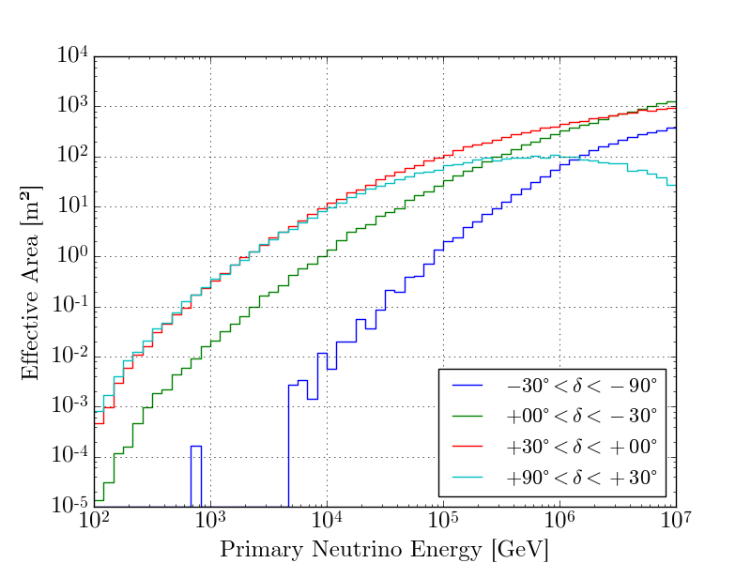
Event selection: effective area
Full sky (4π) sensitivity
Greater effective area in Northern hemisphere than Southern hemisphere (harder cuts used in South to reduce atmospheric muons)

Slide 5
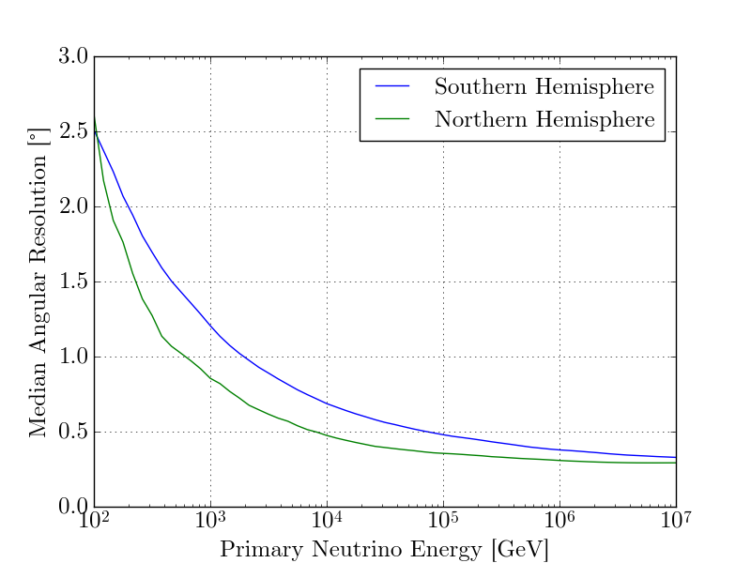
Event selection: angular resolution

Slide 6
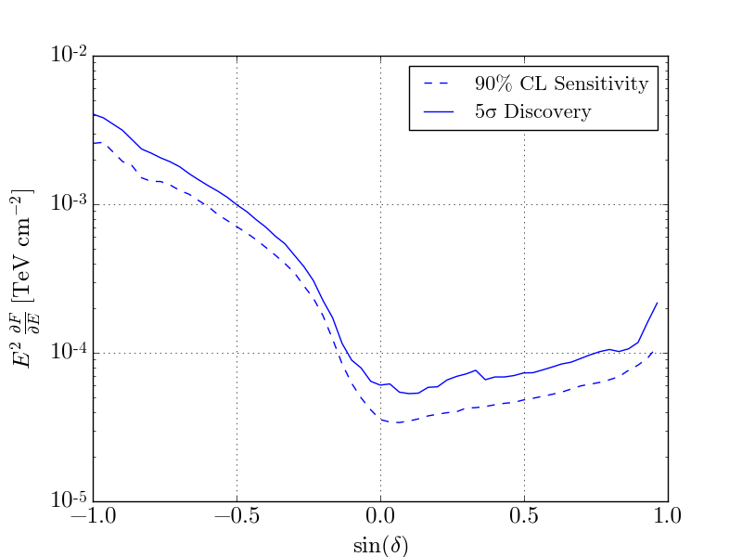
Point source sensitivity
(Example for 10⁵ second duration search window)
South
North
Sensitivity better in North than South; best sensitivity near celestial equator
“Sensitivity”: expected value of upper limit
“Discovery potential”: minimum necessary for 5𝜎 discovery in 50% of realizations
Method: un-binned maximum likelihood (J. Braun et al. Astropart. Phys. 33, 3, 2010)
Notes:
Figure 2 (Left) Pipeline performance as a function of declination, using an analysis lasting 10$^5$ seconds with zero spatial source extension. Most of the declination dependence is a result of background rate variation. The solid line shows the discovery potential, i.e. the minimum flux required to achieve a 5$\sigma$ discovery in 50\% of signal plus background realizations (including Poisson fluctuations of each). The dashed line shows sensitivity, i.e. the 90\% confidence level upper limit corresponding to the the median value of the test statistic for the background-only hypothesis.

Slide 7
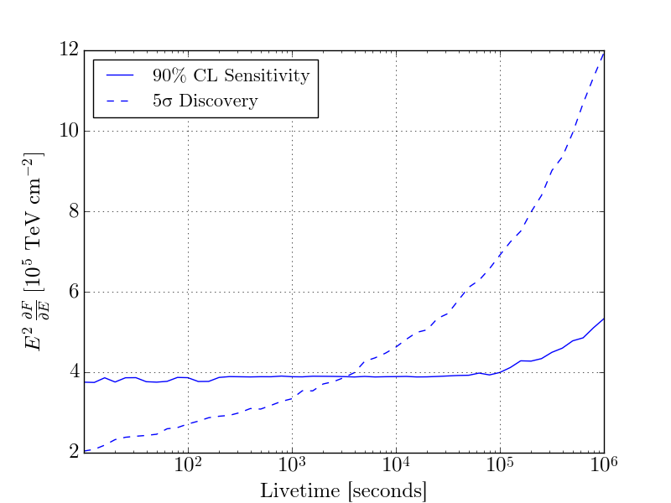
Sensitivity and discovery potential vs. search time window duration
15°declination
zero spatial extension
Notes:
Figure 2 (Right) Time dependence of the pipeline's sensitivity and discovery potential as a function of signal window duration, for declination $\delta = 15^\circ$ and zero spatial source extension. Since the background rate is low, the sensitivity remains flat for timescales less than 10$^5$ seconds. In both plots the flux is time integrated over the analysis window duration.

Slide 8
Fast response analysis pipeline: results (1)

Slide 9
Fast response analysis pipeline: results (2)

Slide 10
Fast response analysis pipeline: results (3)

Slide 11
Fast response analysis pipeline: results (4)

Slide 12
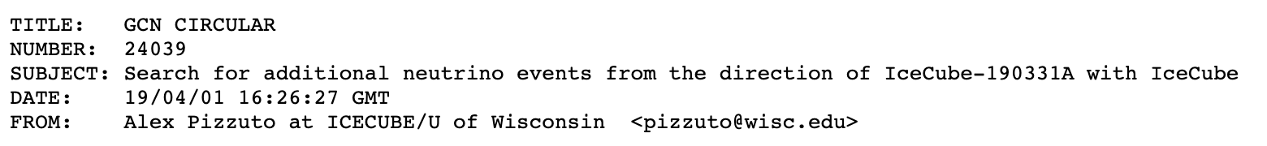
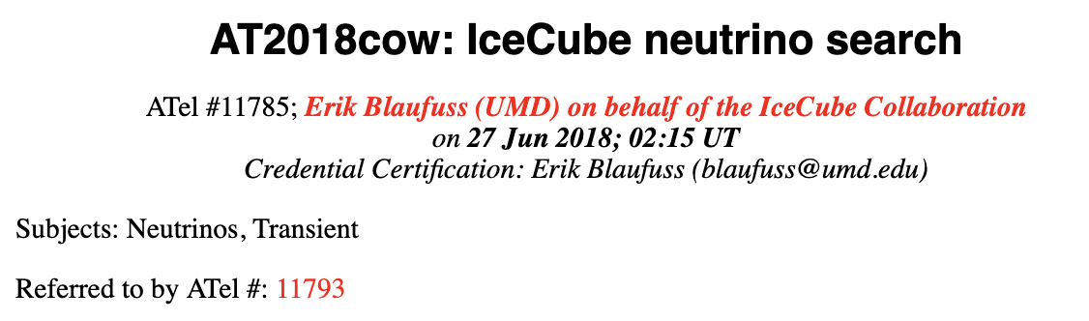


Example interesting analyses
IC-190331A (track with several PeV deposited)
AT 2018 cow
(optical transient)
First 2 real-time, well localized FRBs
Also: IC-170922A, Crab flares, and targets of opportunity with MOU partners

Slide 13
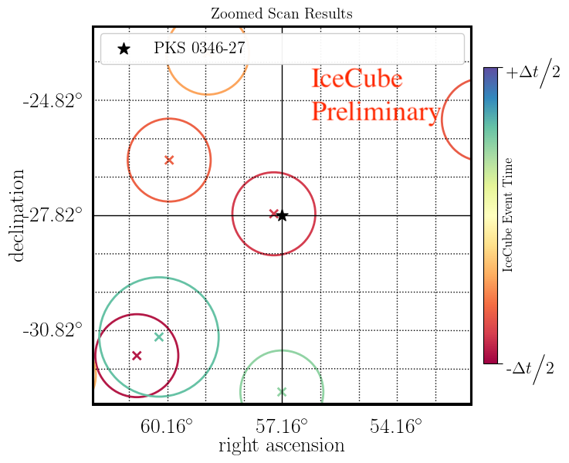
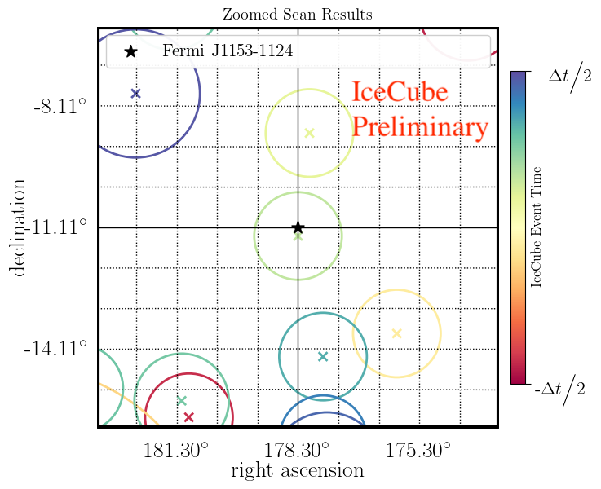
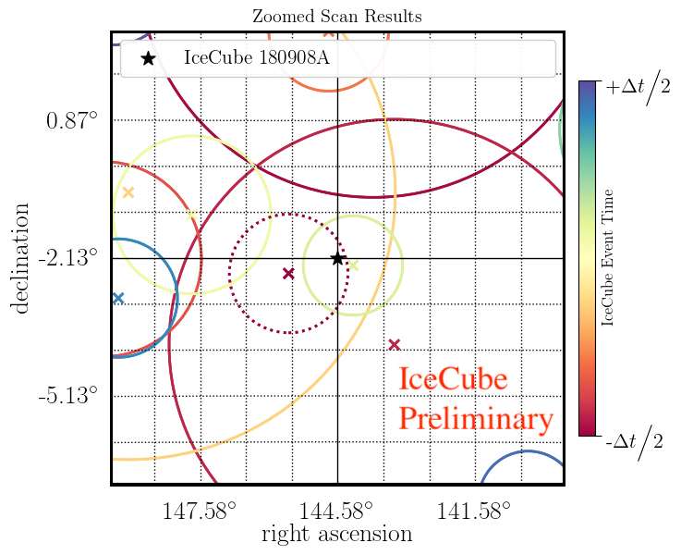
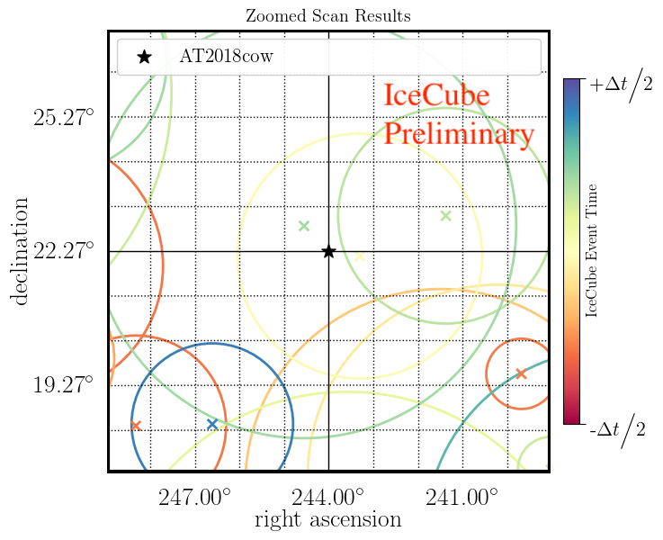
Four most significant analyses: sky maps
PKS 0346-27 (4.8 day)
Fermi J1153-1124 (2 day)
p=0.01
p=0.02
IC-180908A (2 day)
AT2018cow (±3.4 day)
p=0.03
p=0.03
90%
error circles
Notes:
Figure 4: Sky map of IceCube events in the region of interest for the four analyses with smallest p value. The radius of each event circle indicates its angular uncertainty (90\% containment), and the color indicates its time relative to the center of the search window. For each analysis, the analysis duration $\Delta$t is given in Table~\ref{table}
AT2018cow time window based on time between last optical non-detection and first optical detection: 3.4 day

Slide 14
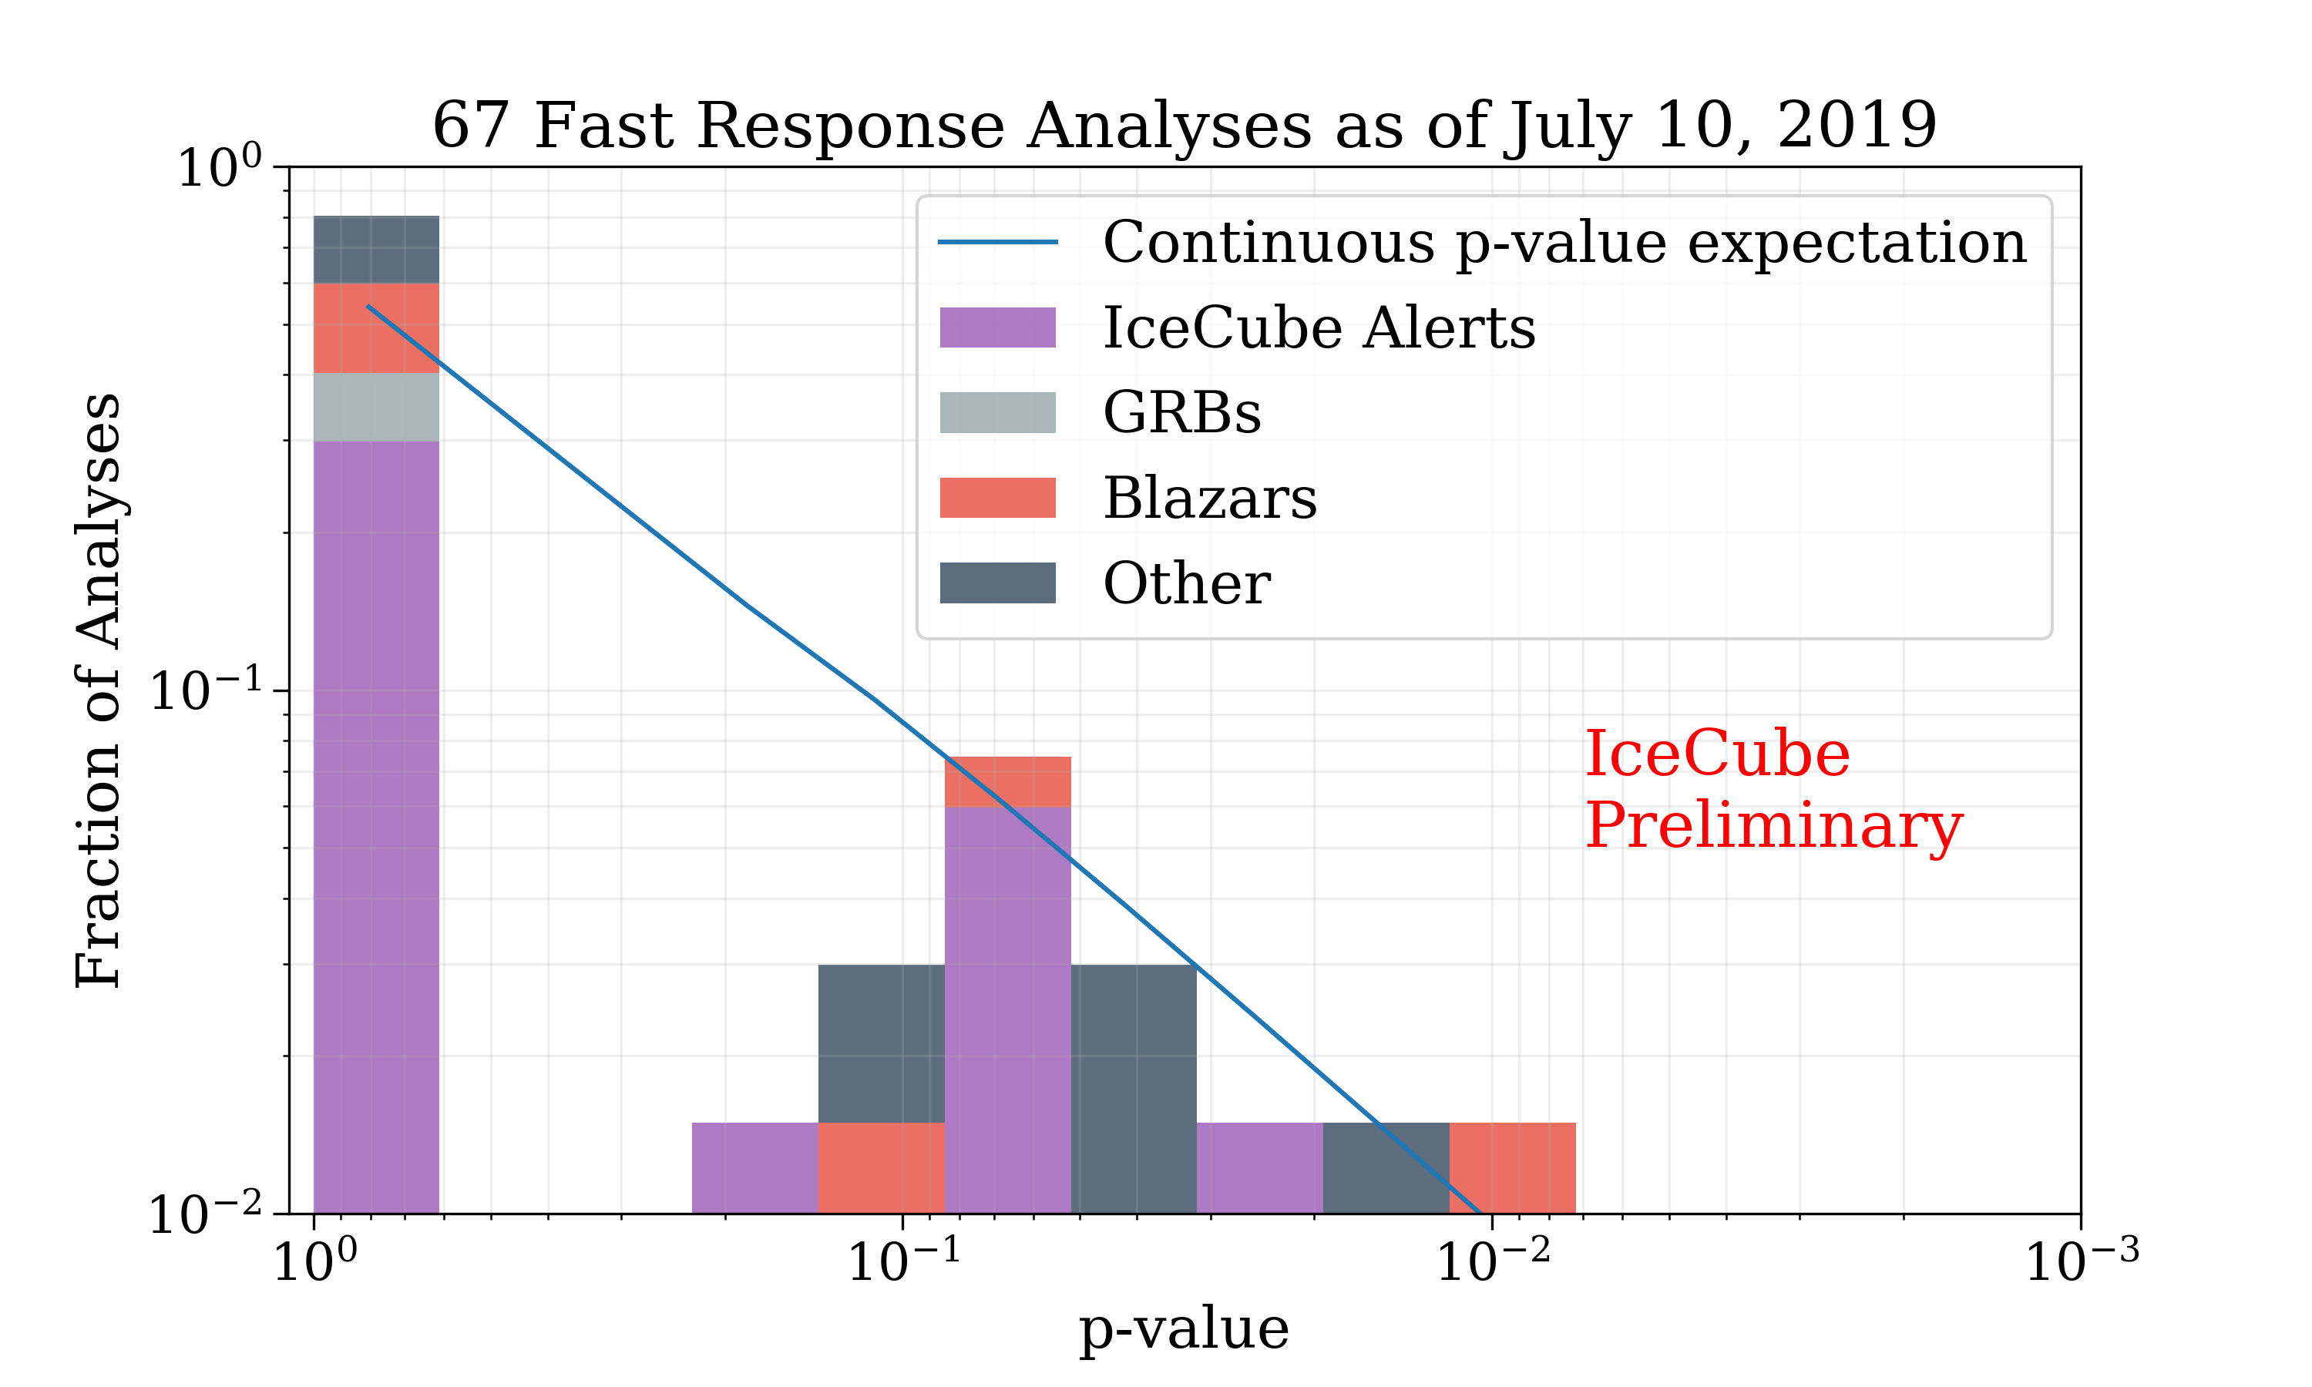
Results: analyzed source classes and p value distribution
No statistically significant signal identified in any analysis by this pipeline to date
Now publishing Astronomer’s Telegram or GCN Circular with results of each analysis, in most cases (including upper limits for E-2 spectrum)
Un-binned maximum likelihood method in low background regime: typically zero or one event on-time and on-direction, so similar to Poisson counting experiment with one cluster of p values for 0 events and one cluster for 1 event
Notes:
Figure 3: P value distribution for all analyses run by the fast response pipeline, separated according to source class, as of July 10, 2019. No analysis has resulted in a statistically significant signal detection. Analyses typically have a short search time window, with an expected number of background events significantly less than one. In this regime, the unbinned maximum likelihood method performs approximately the same as a binned Poisson counting experiment whose p value is determined by the number of counts. Because of this, the p value distribution under the background-only null hypothesis is discrete, with a high fraction of occurrences at $p=1.0$ corresponding to zero events in the signal window, and a separate cluster of p values corresponding to one event in the signal window. The expectation for a continuous, uniform p value distribution is shown for reference.

Slide 15
Conclusion and Outlook
Thanks to its excellent duty cycle (>99%), field of view (4π), and latency (0.5 min), IceCube is well suited to rapidly follow up a wide variety of multi-wavelength and multi-messenger transients
Our Fast Response Analysis pipeline has been up and running since April 2016
Now reporting results of most analyses by ATel or GCN, including upper limits
>74 analyses completed as of July 30, 2019
No analysis has found evidence for a signal (yet!)
Same pipeline also tailored for gravitational waves (R. Hussain NU9d)
Contact IceCube Realtime Oversight Committee if you have a suggestion for an IceCube fast response analysis: roc@icecube.wisc.edu

Slide 16
Additional slides

Slide 17
IceCube-190730A
3:51pm today
//////////////////////////////////////////////////////////////////////
TITLE: GCN/AMON NOTICE
NOTICE_DATE: Tue 30 Jul 19 20:51:11 UT
NOTICE_TYPE: ICECUBE Astrotrack Gold
STREAM: 24
RUN_NUM: 132910
EVENT_NUM: 57145925
SRC_RA: 226.8302d {+15h 07m 19s} (J2000), 227.0663d {+15h 08m 16s} (current), 226.2275d {+15h 04m 55s} (1950)
SRC_DEC: +10.5078d {+10d 30' 28"} (J2000), +10.4334d {+10d 26' 00"} (current), +10.6993d {+10d 41' 58"} (1950)
SRC_ERROR: 45.31 [arcmin radius, stat-only, 90% containment]
SRC_ERROR50: 17.65 [arcmin radius, stat-only, 50% containment]
DISCOVERY_DATE: 18694 TJD; 211 DOY; 19/07/30 (yy/mm/dd)
DISCOVERY_TIME: 75041 SOD {20:50:41.31} UT
REVISION: 0 ENERGY: 2.9881e+02 [TeV]
SIGNALNESS: 6.7158e-01 [dn]
FAR: 0.6770 [yr^-1]
SUN_POSTN: 129.82d {+08h 39m 16s} +18.42d {+18d 24' 58"}
SUN_DIST: 93.47 [deg] Sun_angle= -6.5 [hr] (East of Sun)
MOON_POSTN: 111.51d {+07h 26m 03s} +22.19d {+22d 11' 34"}
MOON_DIST: 108.93 [deg]
GAL_COORDS: 12.06, 53.99 [deg] galactic lon,lat of the event
ECL_COORDS: 221.03, 26.91 [deg] ecliptic lon,lat of the event
COMMENTS: IceCube Gold event. COMMENTS: The position error is statistical only, there is no systematic added.
https://gcn.gsfc.nasa.gov/notices_amon_g_b/132910_57145925.amon

Slide 18
IC-190331A (GCN Circular #24039)
TITLE: GCN CIRCULAR NUMBER: 24039 SUBJECT: Search for additional neutrino events from the direction of IceCube-190331A with IceCube DATE: 19/04/01 16:26:27 GMT FROM: Alex Pizzuto at ICECUBE/U of Wisconsin <pizzuto@wisc.edu> The IceCube Collaboration (http://icecube.wisc.edu/) reports: IceCube has performed a search for additional track-like muon neutrino events arriving from the direction of IceCube-190331A (https://gcn.gsfc.nasa.gov/gcn3/24028.gcn3) in a time range of 2 days centered on the alert event time (2019-03-30 06:55:43.44 UTC to 2019-04-01 06:55:43.44 UTC) during which IceCube was collecting good quality data. Excluding the event that prompted the alert, zero additional track-like events are found in spatial coincidence with the 90% PSF containment of IceCube-190331A. We find that these data are well described by atmospheric background expectations, with a p-value of 1.0. Accordingly, these data would represent a time-integrated muon-neutrino flux upper limit assuming an E^-2 spectrum (E^2 dN/dE) at the 90% CL of 3.0 x 10^-4 TeV cm^-2 for this observation period. 90% of events IceCube would detect from a source at this declination with an E^-2 spectrum are between approximately 10 TeV and 1 PeV. A subsequent search was performed to include the previous month of data (2019-03-01 06:55:43.44 UTC to 2019-04-01 06:55:43.44 UTC). In this case, we also report a p-value of 1.0, consistent with no significant excess of track events, and a corresponding time-integrated muon-neutrino flux upper limit assuming an E^-2 spectrum (E^2 dN/dE) at the 90% CL of 3.8 x 10^-4 TeV cm^-2. The IceCube Neutrino Observatory is a cubic-kilometer neutrino detector operating at the geographic South Pole, Antarctica. The IceCube realtime alert point of contact can be reached at roc@icecube.wisc.edu<mailto:roc@icecube.wisc.edu>

Slide 19
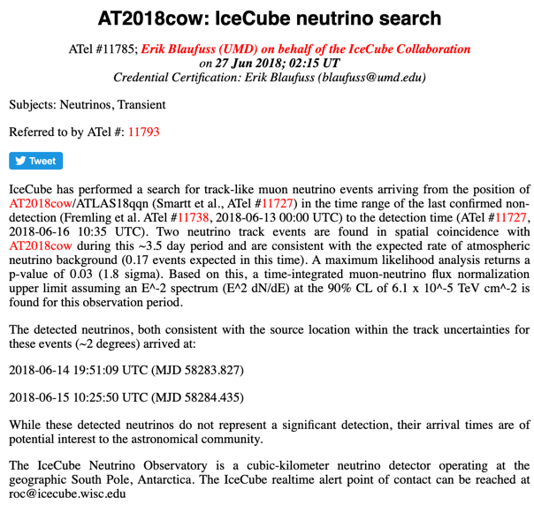

Slide 20
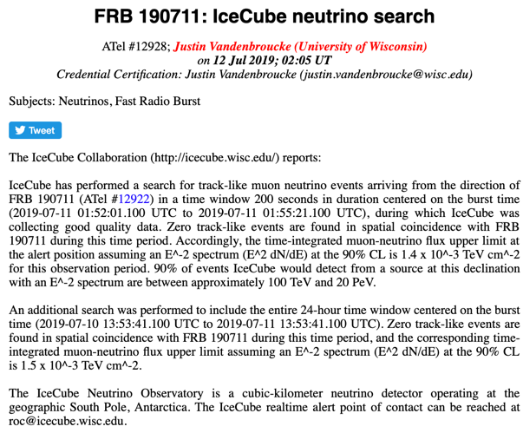

Slide 21
